Slide 1

Making Sense of Real Research #5
“Support and Opposition for Invading Iraq:
Did the President’s Speech Make a
Difference?”
By Juanita Firestone and Richard Harris
This article appeared in the
International Journal of
Public Administration in 2006.
This Article Analysis will
guide you through the article
in two ways:
Blue Commentary Boxes:
Linneman’s comments to help you
understand elements in the article.
Green Question Boxes:
Linneman’s questions for you about
elements in the article. Answer the
question for yourself, and then click
on the box to see Linneman’s answer.
Click the box again to return to the
question.

Slide 2
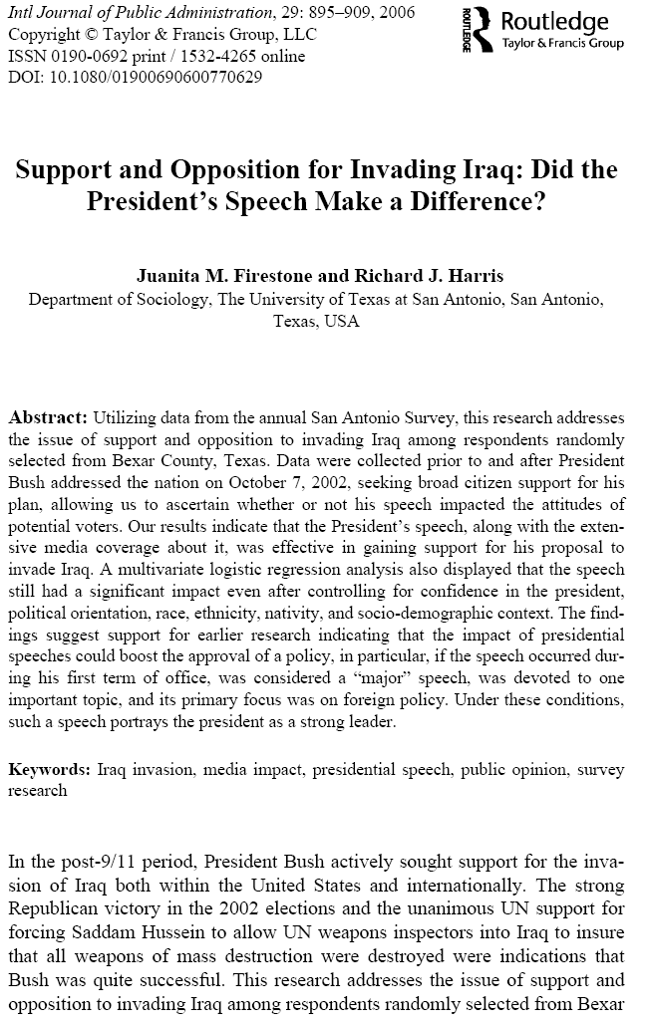
Comment 1:
This article offers a good example of results from a smaller-scale survey project.

Slide 3
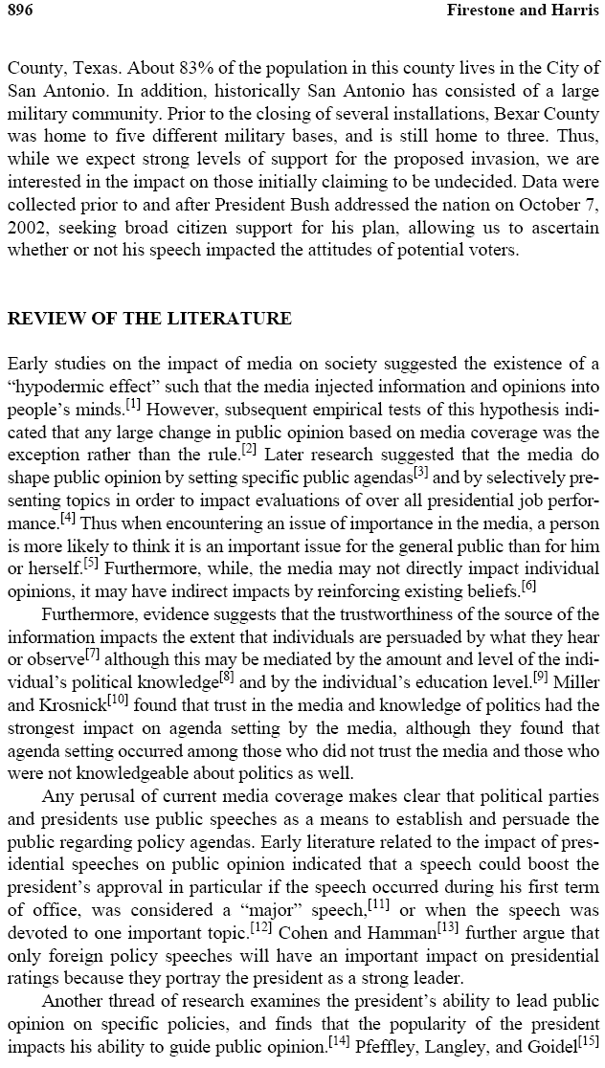
Comment 2:
This project is a sort of “natural” experiment: where a stimulus that occurs naturally (Bush’s speech) is used as the key independent variable.

Slide 4
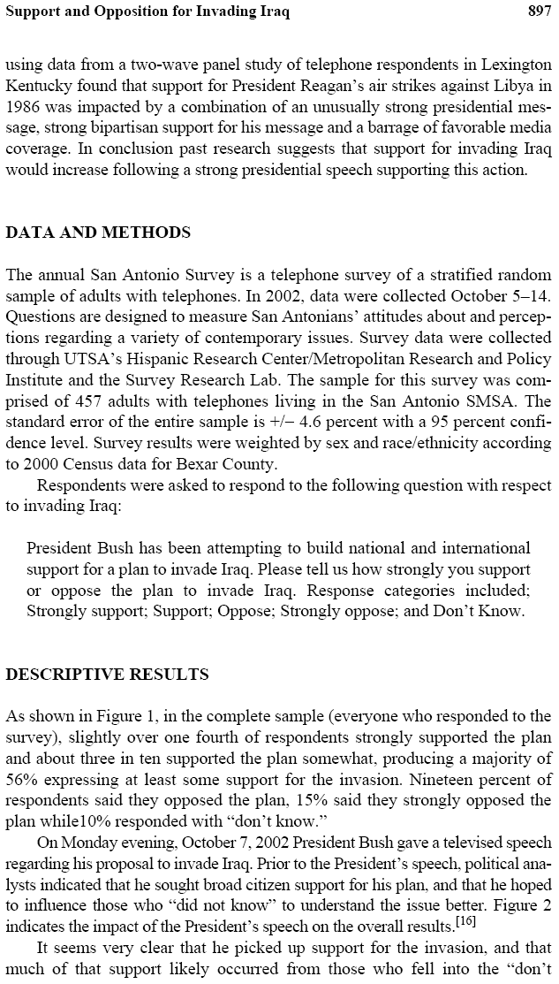
Question 1:
Given what you know about confidence intervals, why is it not appropriate to talk about the standard error for an entire sample?

Slide 5
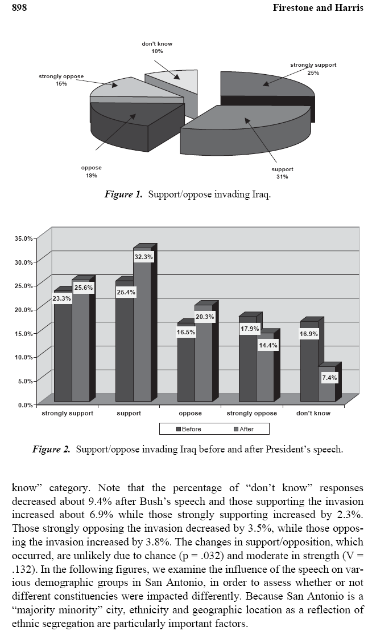
Question 2:
What test did the authors likely use to get this p value?
Comment 3:
V is similar to a correlation coefficient, measuring the strength of a relationship.

Slide 6
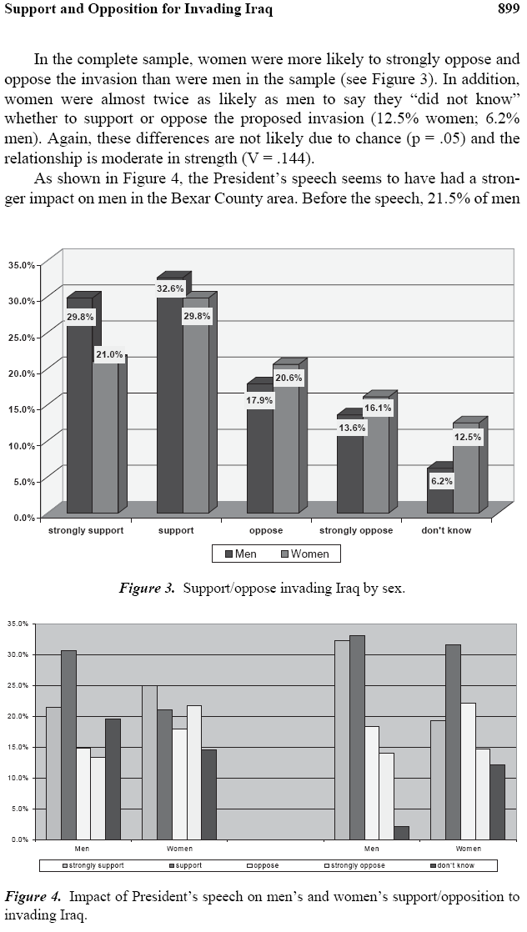
Question 3:
Explain how the authors are now engaging in the technique of elaboration.

Slide 7
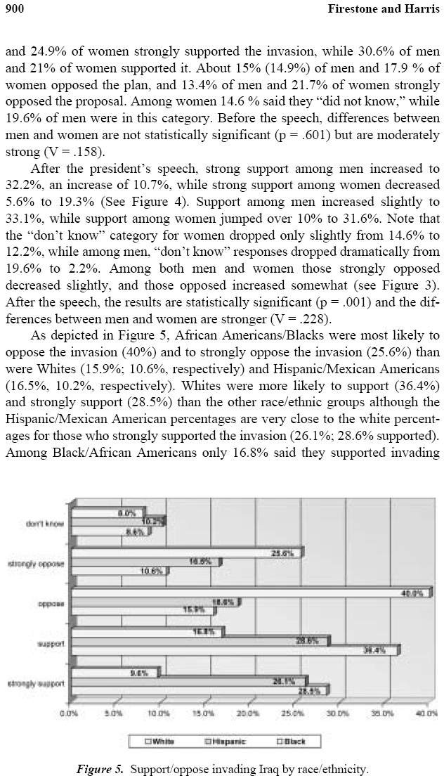

Slide 8
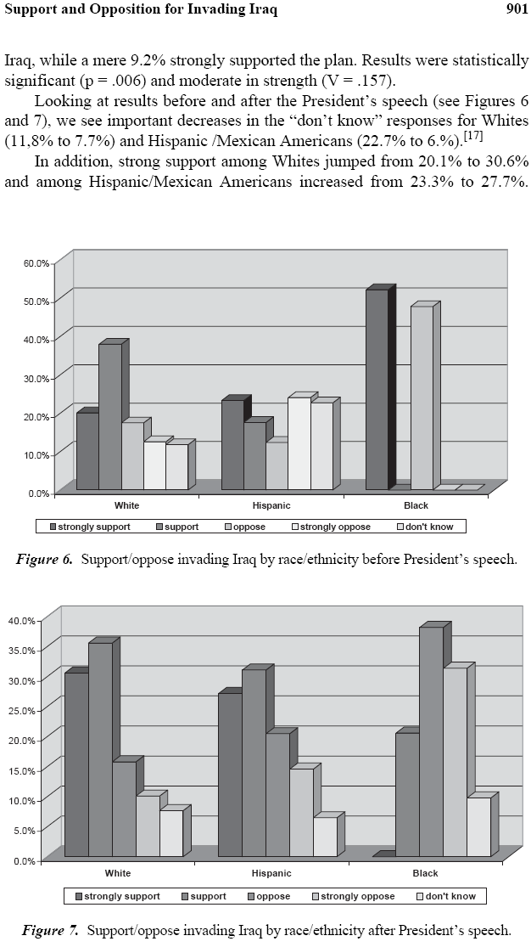
Comment 4:
Note Endnote 17, which describes that the sample size for Black people is very low. This happens with elaboration with a small sample.

Slide 9
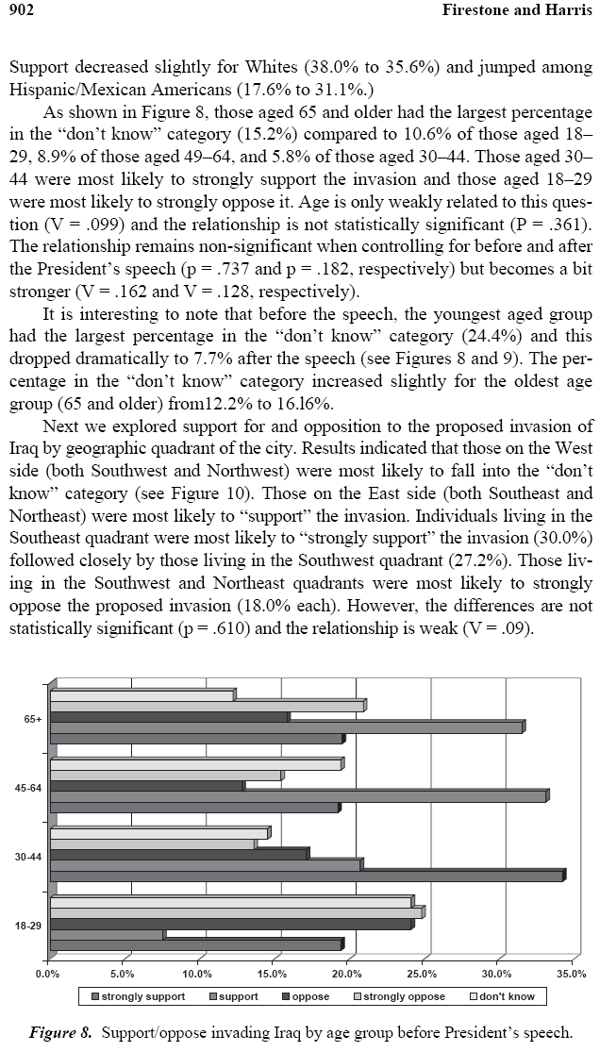
Comment 5:
The authors don’t explain their hypothesis regarding why they expected a difference based on geography.

Slide 10
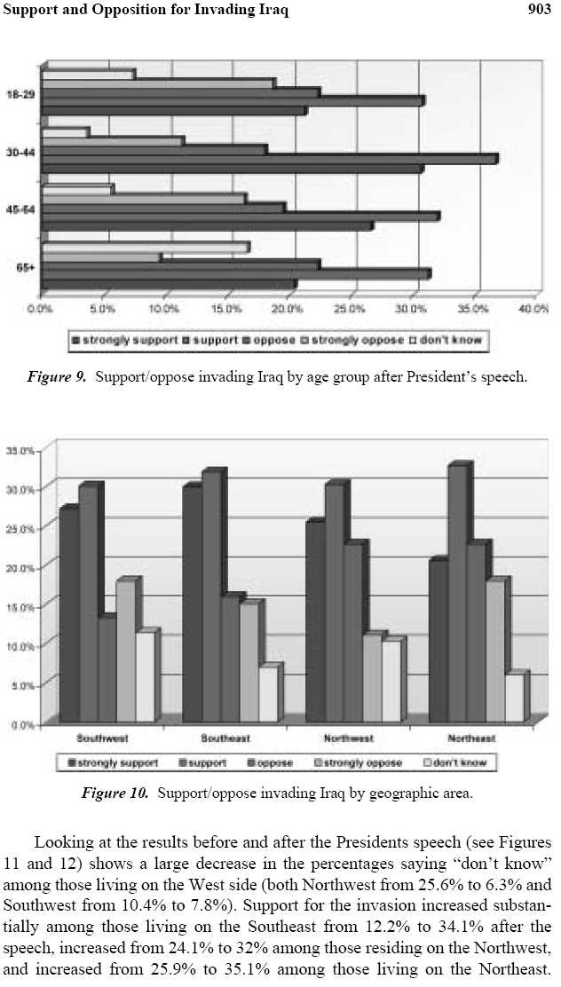

Slide 11
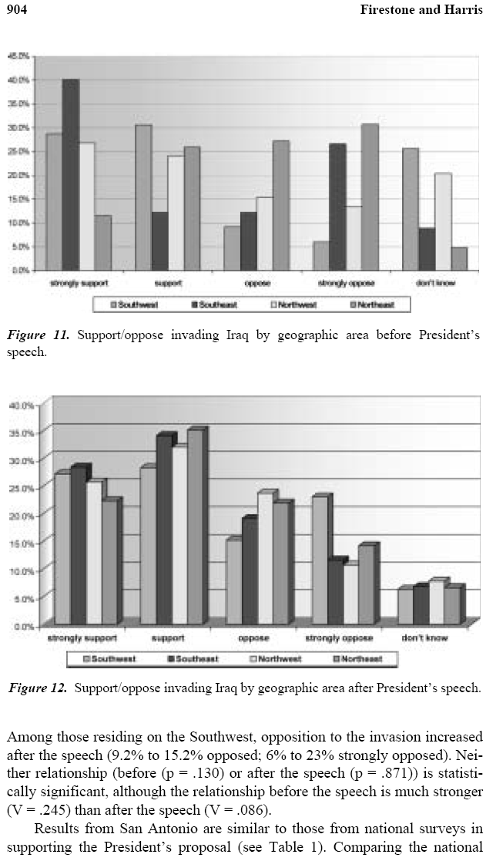

Slide 12
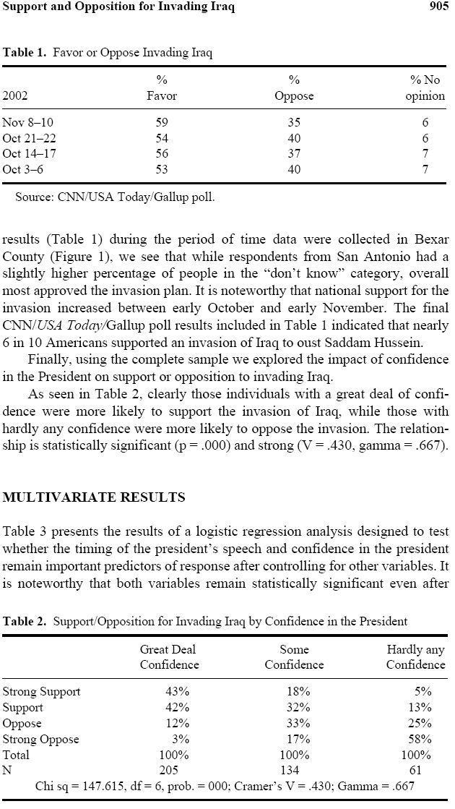
Question 4:
Could you run a chi-square test on this table with the given information?
Question 5:
Why are there six degrees of freedom in Table 2?
Comment 6:
Gamma is another measure of association, similar to the correlation coefficient.

Slide 13
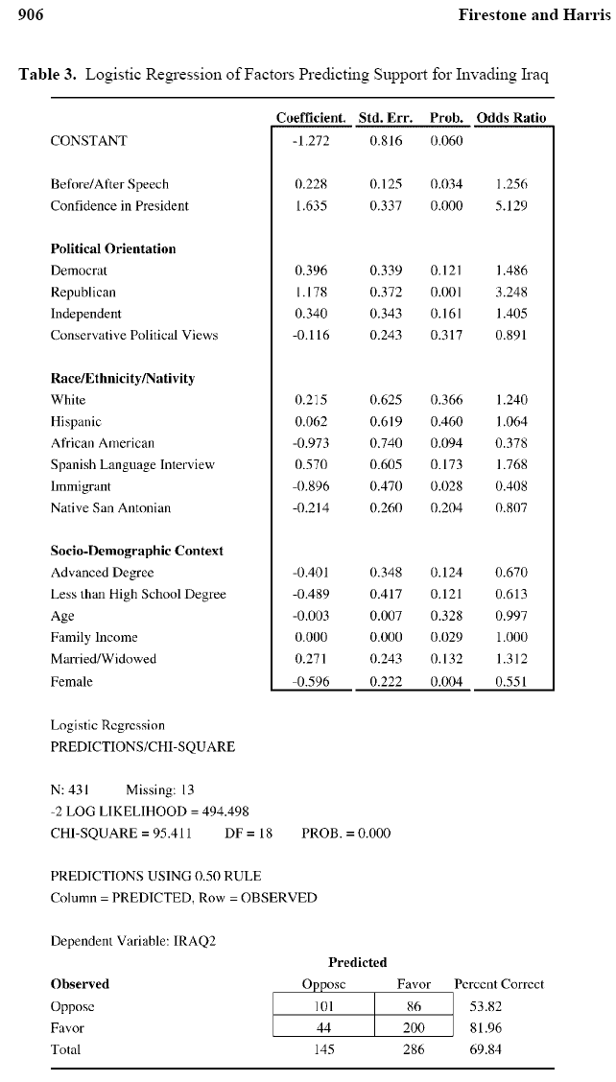
Question 6:
Why are they using logistic regression?
Question 7:
Given the results earlier in the article, how was this variable coded for the regression?
Question 8:
How does the model refute this claim:
Republicans support the invasion because they have more confidence in the president.
Comment 7:
Some of these variables seem to be reference grouped, but the authors don’t tell us what the reference groups are.
Comment 8:
Rather than R², the authors use this technique to show how the model performs.

Slide 14
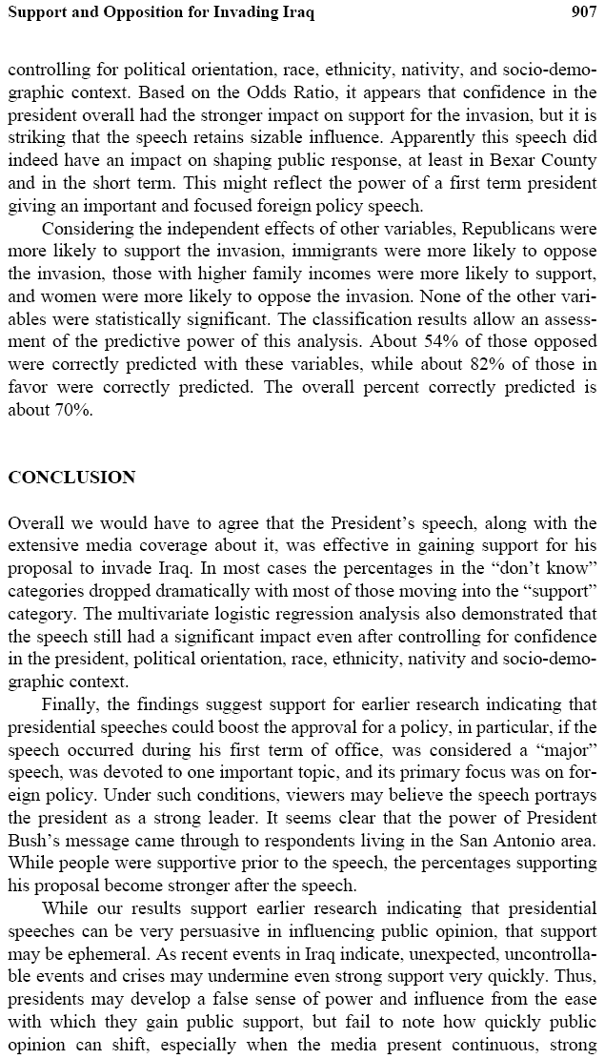

Slide 15
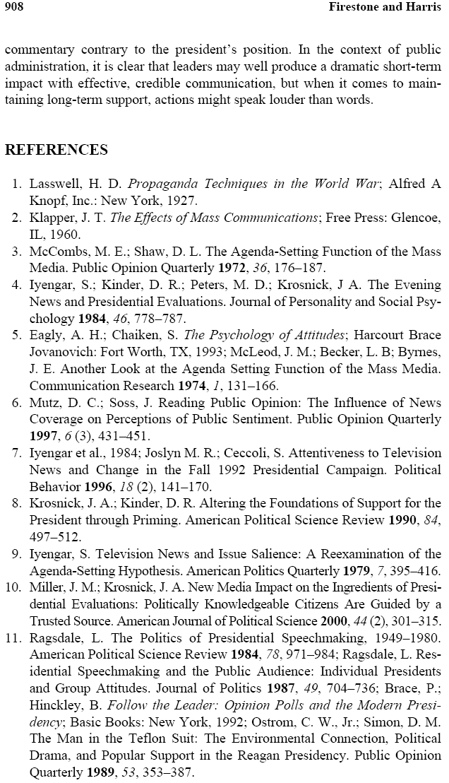

Slide 16
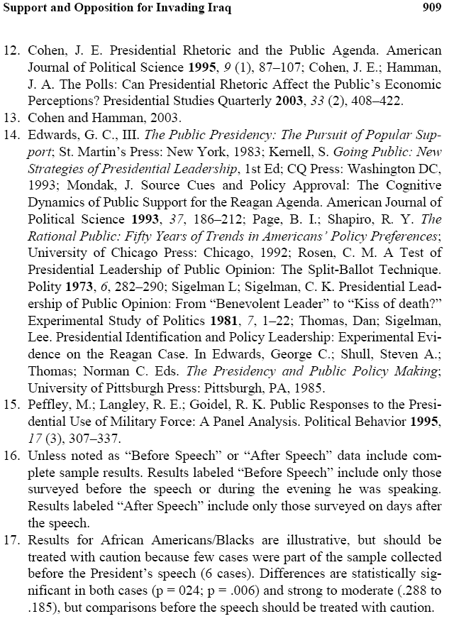
Comment 9:
This is the end of “Making Sense of Real Research #5.”
The following slides contain the answers to the questions.

Slide 17
Question 1:
Since the value of the standard error is based on variation, and since different variables have different levels of variation, there can be no overall standard error for the whole sample, only for individual questions.

Slide 18
Question 2:
Since it’s a dichotomy and an ordinal-level variable, they likely used a chi-square test.
Comment 3:
V is similar to a correlation coefficient, measuring the strength of a relationship.

Slide 19
Question 3:
They are taking the original relationship (the effect of speech on support) and showing where it does and does not exist.

Slide 20
Question 4:
No, you could not run a chi-square test using this table, as the table provides only percents, and chi-square requires frequencies.
Question 5:
Why are there six degrees of freedom in Table 2?
Comment 6:
Gamma is another measure of association, similar to the correlation coefficient.

Slide 21
Question 4:
Could you run a chi-square test on this table with the given information?
Question 5:
There are three columns and four rows, so:
df=(3-1)(4-1)=6
Comment 6:
Gamma is another measure of association, similar to the correlation coefficient.

Slide 22
Question 6:
The dependent variable is support OR not support.
Question 7:
Given the results earlier in the article, how was this variable coded for the regression?
Question 8:
How does the model refute this claim:
Republicans support the invasion because they have more confidence in the president.
Comment 7:
Some of these variables seem to be reference grouped, but the authors don’t tell us what the reference groups are.
Comment 8:
Rather than R², the authors use this technique to show how the model performs.

Slide 23
Question 6:
Why are they using logistic regression?
Question 7:
Before=0, After=1
since the slope is positive, meaning more support after the speech.
Question 8:
How does the model refute this claim:
Republicans support the invasion because they have more confidence in the president.
Comment 7:
Some of these variables seem to be reference grouped, but the authors don’t tell us what the reference groups are.
Comment 8:
Rather than R², the authors use this technique to show how the model performs.

Slide 24
Question 6:
Why are they using logistic regression?
Question 7:
Given the results earlier in the article, how was this variable coded for the regression?
Question 8:
Confidence is already in the model, so the effect of being Republican is a separate effect, above and beyond confidence in the president.
Comment 7:
Some of these variables seem to be reference grouped, but the authors don’t tell us what the reference groups are.
Comment 8:
Rather than R², the authors use this technique to show how the model performs.

