Slide 1

Making Sense of Real Research #4
“HIV Risk Exposure among South African
Children in Public Health Facilities”
By Olive Shisana et al
This article appeared in the
journal AIDS Care in 2008.
This Article Analysis will
guide you through the article
in two ways:
Blue Commentary Boxes:
Linneman’s comments to help you
understand elements in the article.
Green Question Boxes:
Linneman’s questions for you about
elements in the article. Answer the
question for yourself, and then click
on the box to see Linneman’s answer.
Click the box again to return to the
question.

Slide 2
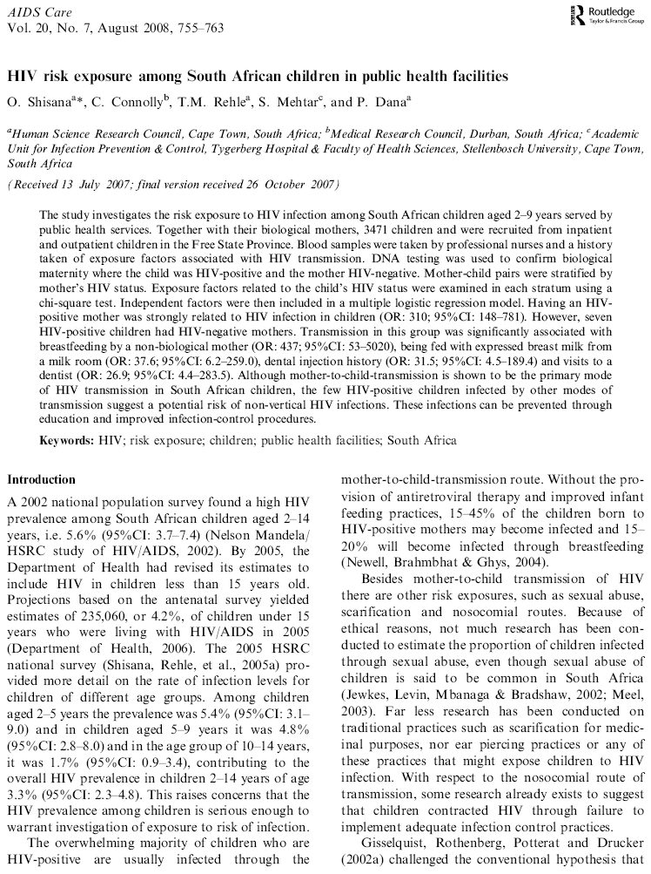
Comment 1:
OR stands for Odds Ratio, and CI stands for Confidence Interval. A lot of the questions below will be related to both of these.

Slide 3
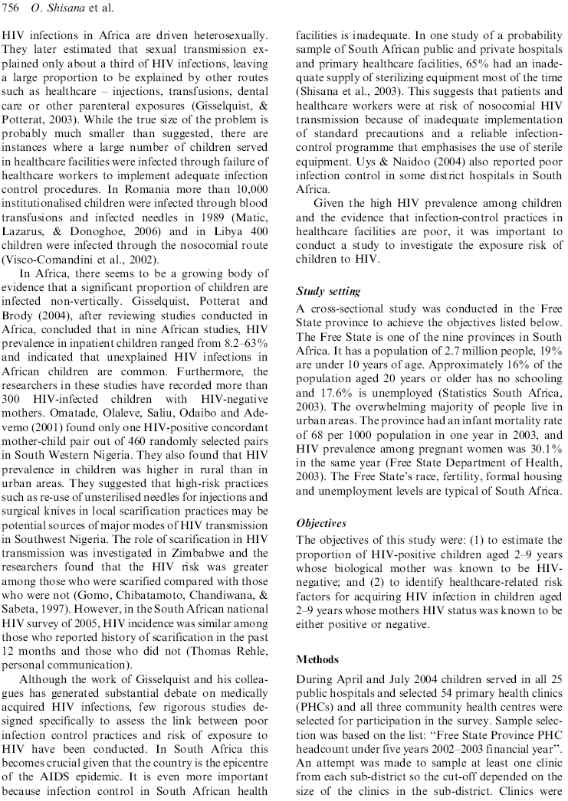

Slide 4
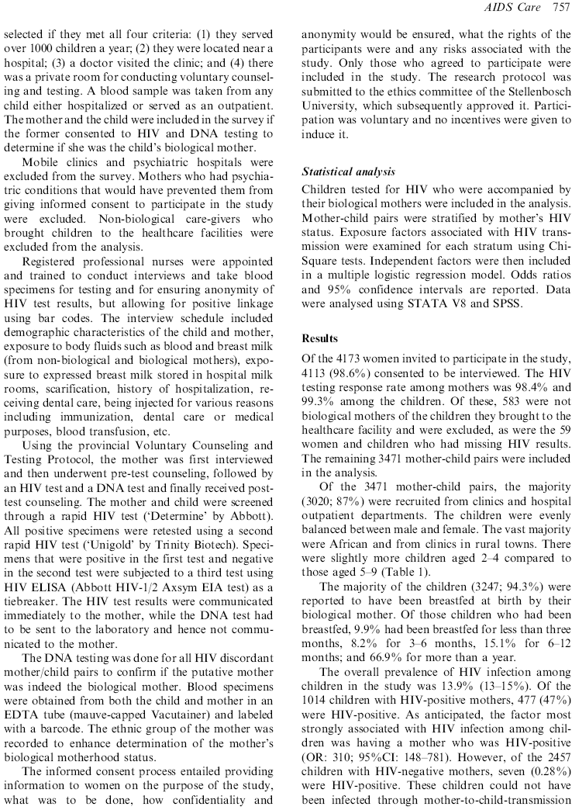
Comment 2:
This is a good example of how researchers define their sample.

Slide 5
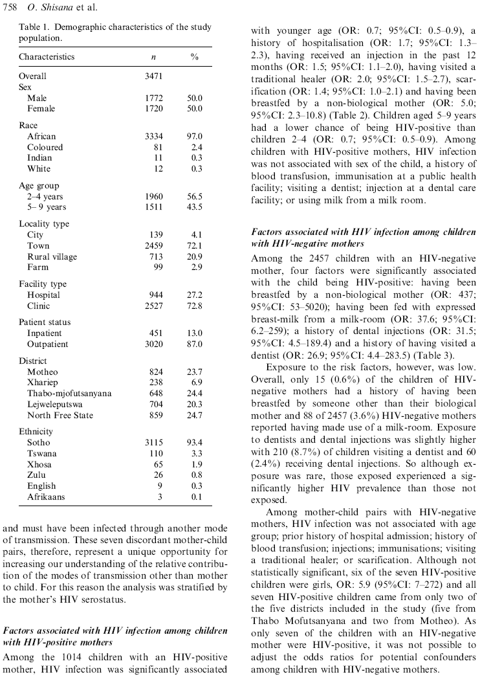
Question 1:
What do they mean when they say “the analysis was stratified”?

Slide 6
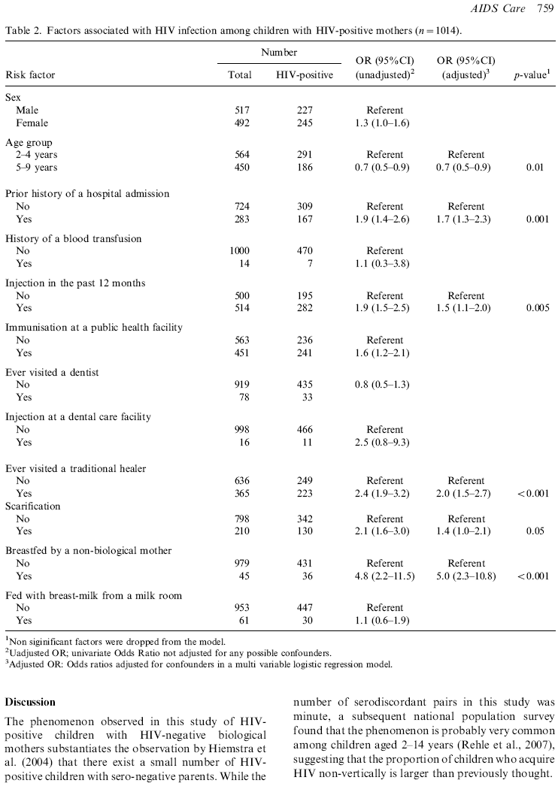
Comment 3:
Here is how they calculated this odds ratio:
Among those 2-4 years:
291 HIV-positive
564-291=273 HIV-negative.
291/273=1.0659
Among those 5-9 years:
186 HIV-positive
450-186=264 HIV-negative.
186/284=.7045
.7045/1.0659=.7
Question 2:
Show how they calculated this odds ratio.
Question 3:
Interpret these CIs. Why is one so much wider than the other?
Comment 4:
Confounders is another word for “other variables in the model”.
Question 4:
Interpret this p-value.

Slide 7
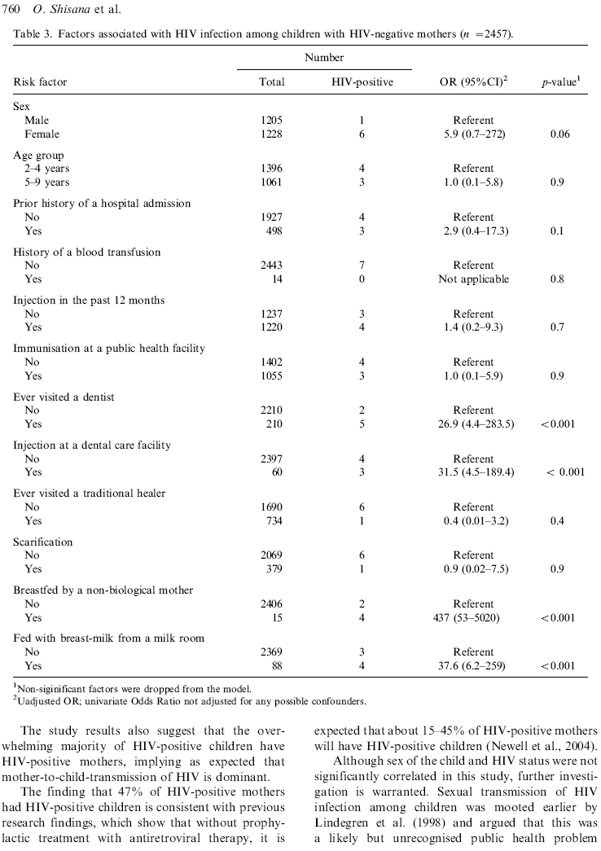
Question 5:
What is the primary difference between Tables 2 & 3?
Question 6:
If the number 1 is within the range of these confidence intervals, the p-value is not significant. Explain why this is.
Question 7:
Show how they calculated this odds ratio.
Question 8:
Show how they calculated this odds ratio.

Slide 8
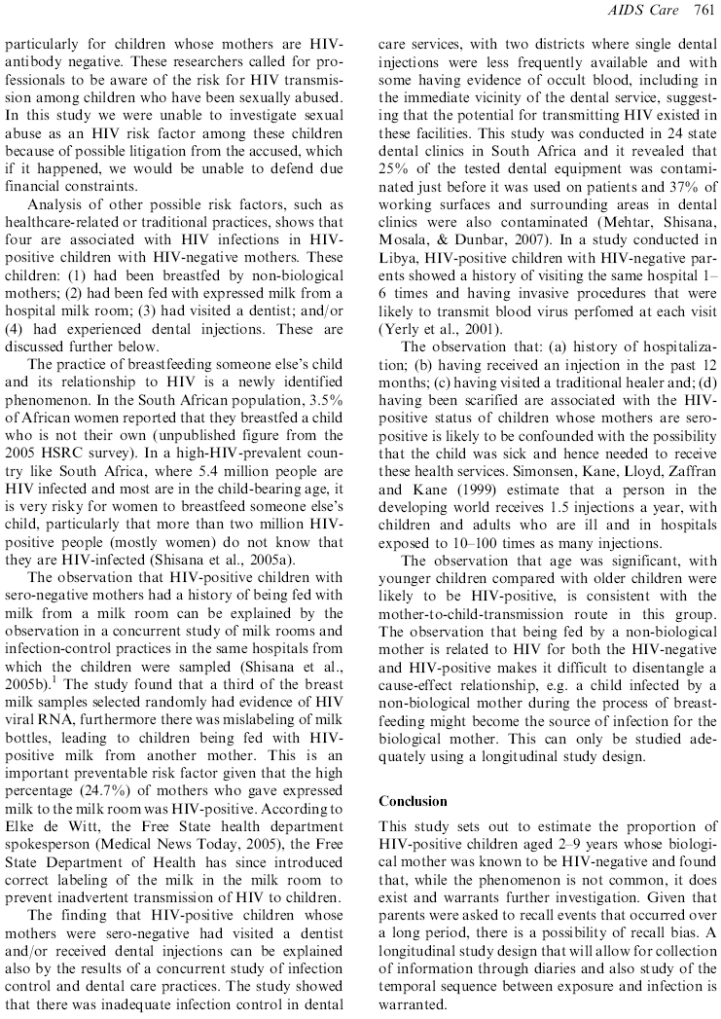

Slide 9
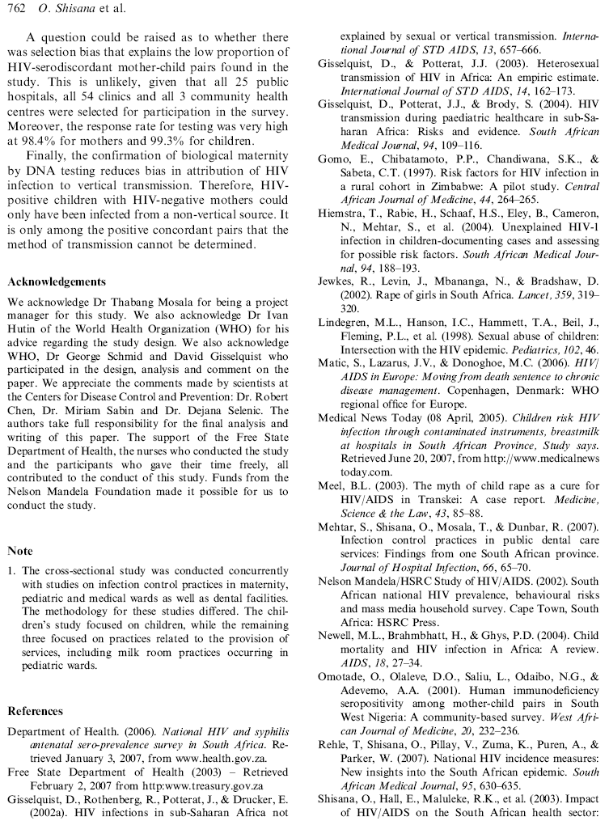
Comment 5:
This is a common strategy for the end of an article: predicting possible criticisms of the research and dealing with them.

Slide 10
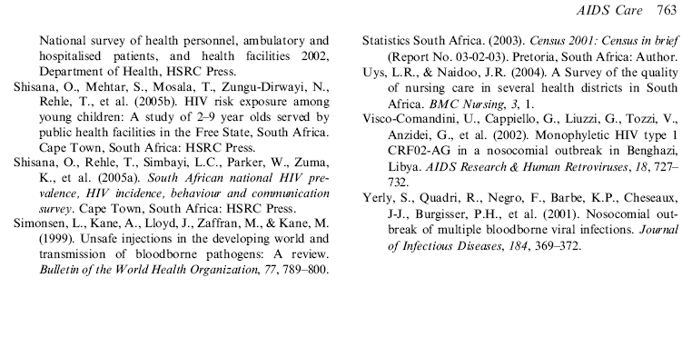
Comment 6:
This is the end of “Making Sense of Real Research #4.”
The following slides contain the answers to the questions.

Slide 11
Question 1:
It means that they ran separate analyses: one for HIV-positive mothers, and one for HIV-negative mothers.

Slide 12
Comment 3:
Here is how they calculated this odds ratio:
Among those 2-4 years:
291 HIV-positive
564-291=273 HIV-negative.
291/273=1.0659
Among those 5-9 years:
186 HIV-positive
450-186=264 HIV-negative.
186/284=.7045
.7045/1.0659=.7
Question 2:
Among those w/o an injection:
195 HIV+,
305 HIV-,
195/305=.6393
Among those
w/ an injection:
282 HIV+,
232 HIV-,
282/232=1.2155
1.2155/.6393=
1.9

Slide 13
Comment 3:
Here is how they calculated this odds ratio:
Among those 2-4 years:
291 HIV-positive
564-291=273 HIV-negative.
291/273=1.0659
Among those 5-9 years:
186 HIV-positive
450-186=264 HIV-negative.
186/284=.7045
.7045/1.0659=.7
Question 2:
Show how they calculated this odds ratio.
Question 3:
The population odds ratio is within the range of 0.8 and 9.3.
The first CI is so much wider than the second CI because the first CI has a group with a very small sample size.

Slide 14
Comment 3:
Here is how they calculated this odds ratio:
Among those 2-4 years:
291 HIV-positive
564-291=273 HIV-negative.
291/273=1.0659
Among those 5-9 years:
186 HIV-positive
450-186=264 HIV-negative.
186/284=.7045
.7045/1.0659=.7
Question 2:
Show how they calculated this odds ratio.
Question 3:
Interpret these CIs. Why is one so much wider than the other?
Comment 4:
Confounders is another word for “other variables in the model”.
Question 4:
The odds for one population are significantly different than the odds of the other population, and we can be quite sure about this at a high level of certainty.

Slide 15
Question 5:
Table 2 uses only the HIV+ mothers, while Table 3 uses only the HIV- mothers.
Question 6:
If the number 1 is within the range of a confidence interval, the p-value is not significant. Explain why this is.
Question 7:
Show how they calculated this odds ratio.
Question 8:
Show how they calculated this odds ratio.

Slide 16
Question 5:
What is the primary difference between Tables 2 & 3?
Question 6:
1 means the odds for the two populations are the same, so if this is a possibility, we can’t say that there is a significant difference between the groups.
Question 7:
Show how they calculated this odds ratio.
Question 8:
Show how they calculated this odds ratio.

Slide 17
Question 5:
What is the primary difference between Tables 2 & 3?
Question 6:
If the number 1 is within the range of a confidence interval, the p-value is not significant. Explain why this is.
Question 7:
Odds for those without injections:
4/2393=.001672
Odds for those with injections:
3/57=.05632
Odds ratio:
.05632/.001672=31.5

Slide 18
Question 5:
What is the primary difference between Tables 2 & 3?
Question 6:
If the number 1 is within the range of a confidence interval, the p-value is not significant. Explain why this is.
Question 7:
Show how they calculated this odds ratio.
Question 8:
Odds for NO:
2/2404=.000832
Odds for YES:
4/11=.363636
Odds ratio:
.363636/.000832=437

