Slide 1
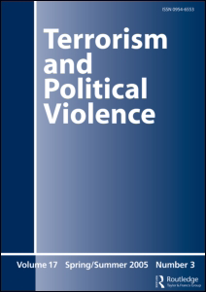
Making Sense of Real Research #3
“Rooted in Poverty? Terrorism, Poor
Economic Development, and Social
Cleavages” By James A. Piazza
This article appeared in the
journal Terrorism and
Political Violence in 2006.
This article analysis will
guide you through the article
in two ways:
Blue Commentary Boxes:
Linneman’s comments to help you
understand elements in the article.
Green Question Boxes:
Linneman’s questions for you about
elements in the article. Answer the
question for yourself, and then click
on the box to see Linneman’s answer.
Click the box again to return to the
question.

Slide 2
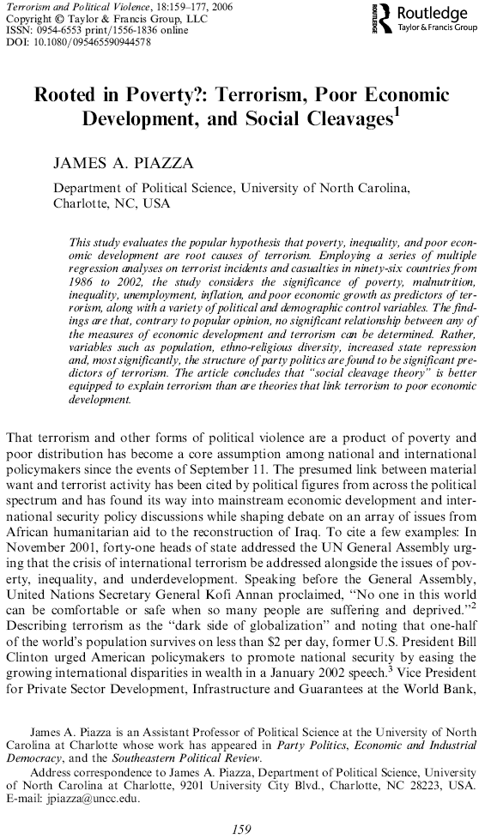
Comment 1:
This is an example of an article where a lack of a relationship is a major finding: he finds that the economic
variables have no effects in his models.

Slide 3
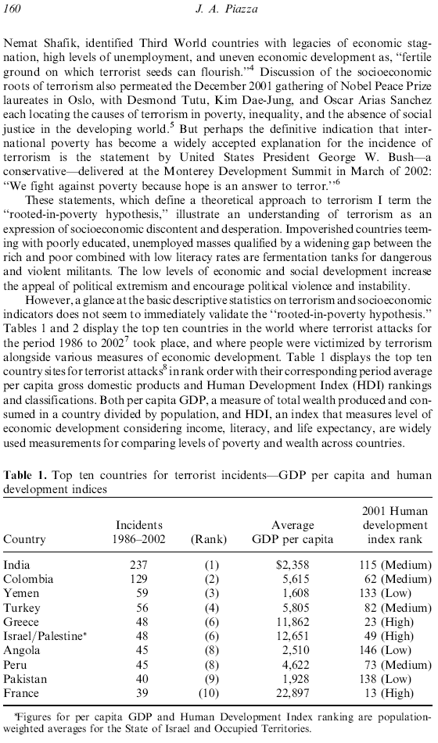
Question 1:
Create a simple regression equation using GDP as your independent variable and number of incidents as your dependent variable.
Report the full equation, adjusted r² value, and the significance of the slope.

Slide 4
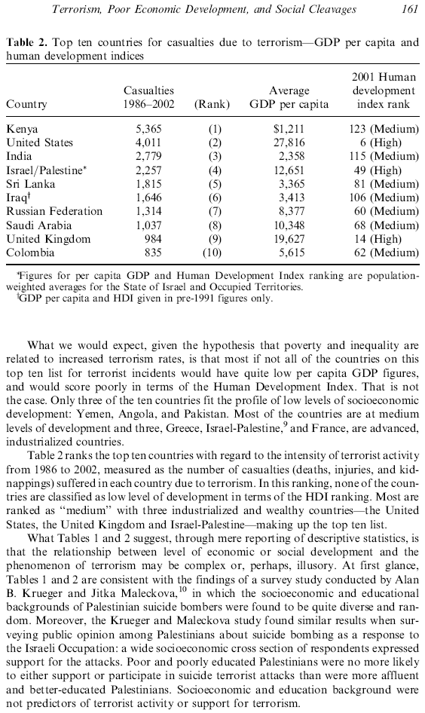
Comment 2:
This is an interesting strategy: showing that
the theoretical ideas work at a different unit of analysis. The article uses the country level of analysis. The author here cites research where the individual is the unit of analysis.

Slide 5
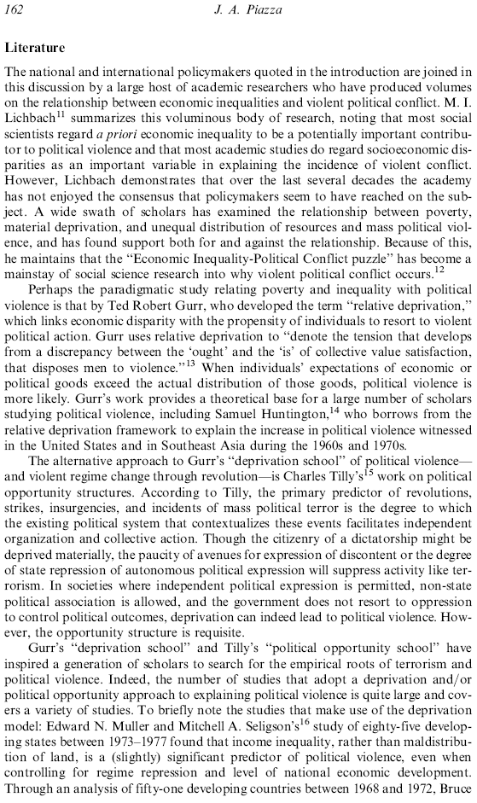
Comment 3:
Skim from here to the middle of page 164.

Slide 6
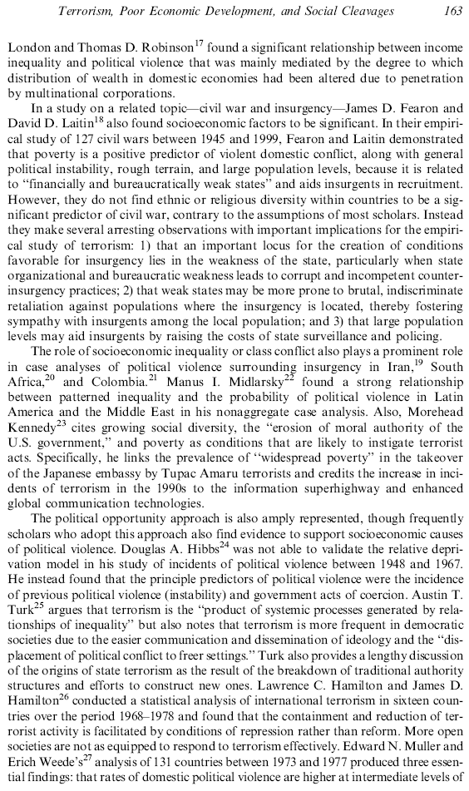

Slide 7
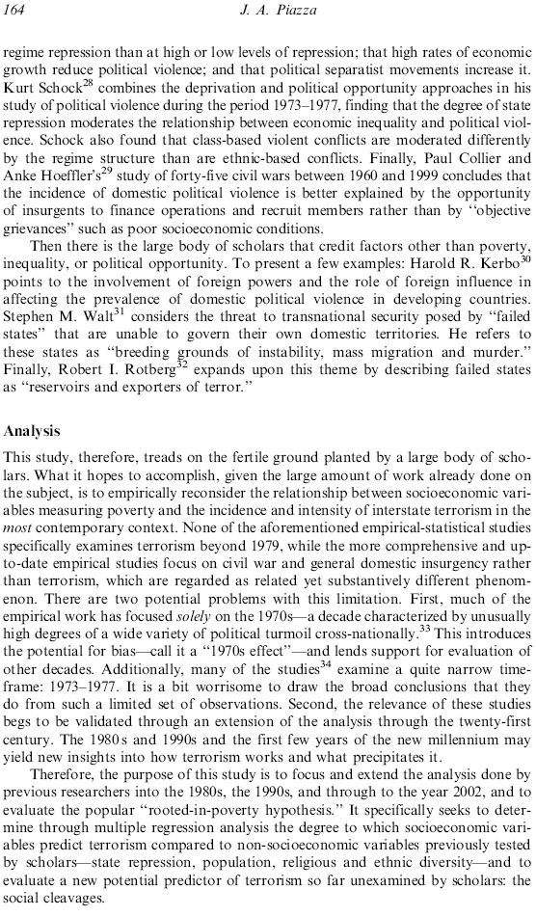
Question 2:
What are the two major differences between the research in this article and previous research?

Slide 8
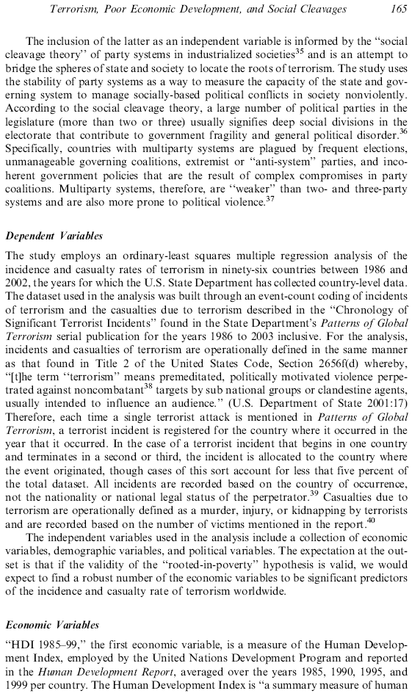
Comment 4:
Measuring terrorism, as you likely can imagine, is a difficult task indeed. Look at all the details involved in how the author measures it.

Slide 9
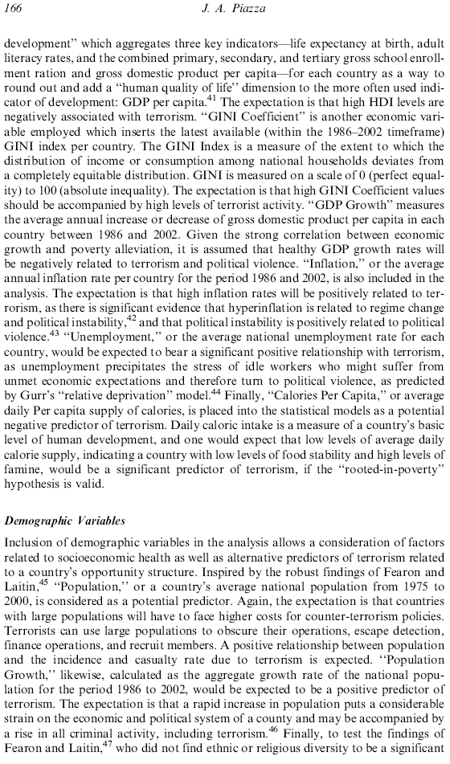
Comment 5:
The GINI coefficient in an index of inequality, just like the IQV is an index of diversity.
Question 3:
Would you want to live in a society where the GINI coefficient was 0? Why or why not?
Comment 6:
As you can see, a lot of what researchers do in articles is define how they measured their variables. Please note that, in addition to these descriptions, there is an appendix on page 174.

Slide 10
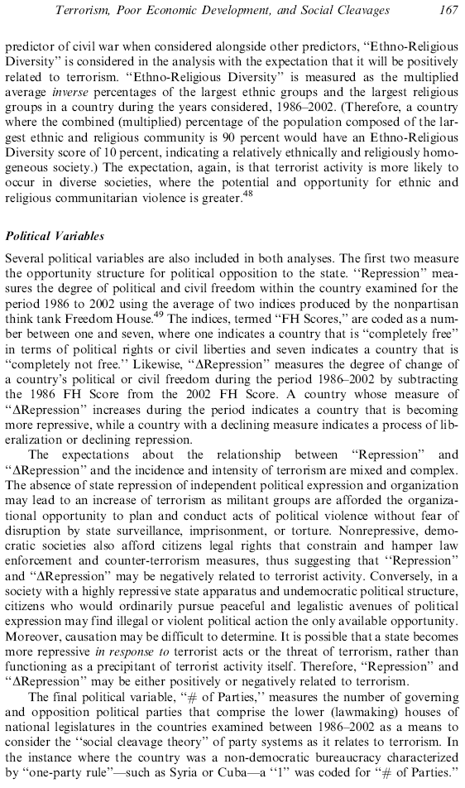
Comment 7:
Don’t get hung up on how this variable is measured. Just understand that it goes from 0 to 100, where 0 is no diversity and 100 is maximum diversity.
Comment 8:
Freedom House is a well respected source of global political data.
Question 4:
If the country of Statsylvania was completely free in 1986, but by 2002 was completely not free, what would its value on the “Change in Repression” variable be?

Slide 11
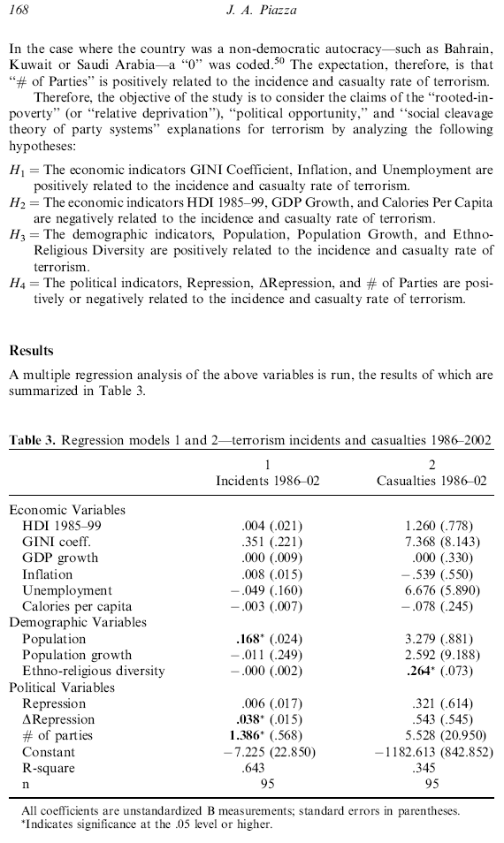
Comment 9:
Having the standard error of the slope next to, or below, the slope is typical in articles.
Comment 10:
Note the odd star meaning here: a * means it’s statistically
significant, but at what level, we don’t know.
Question 5:
Which is easier to explain: incidents or casualties?
Question 6:
Fully interpret this slope.
Question 7:
What effect does diversity have on casualties?
Comment 11:
According to page 170,
this slope should be starred as significant.

Slide 12
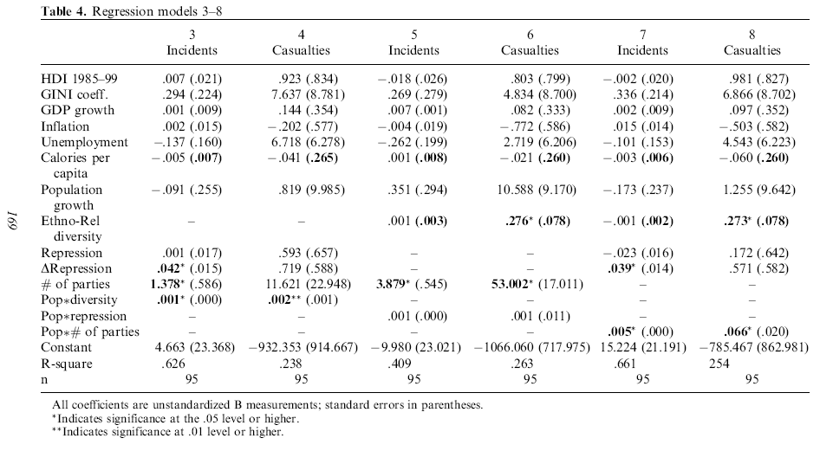
Question 9:
What question does this interaction effect address?
Comment 12:
The way the article presents the interaction effects is rather odd: it seems that the parent slopes are not included.
Question 8:
What question does this interaction effect address?

Slide 13
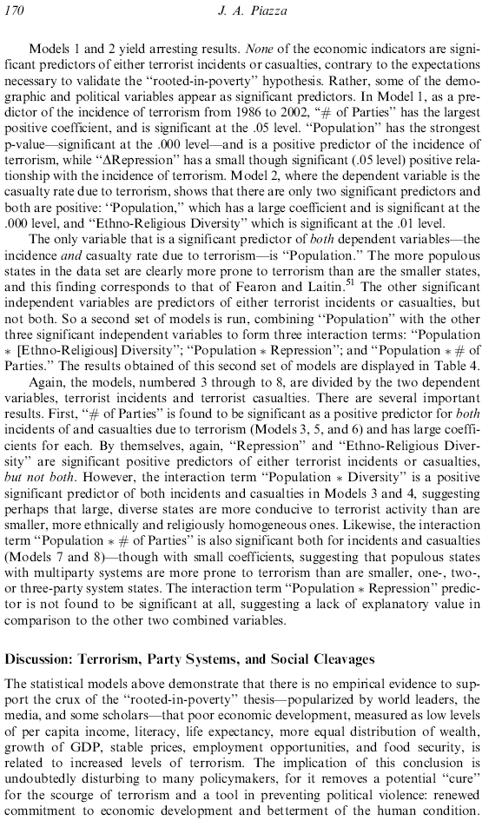

Slide 14
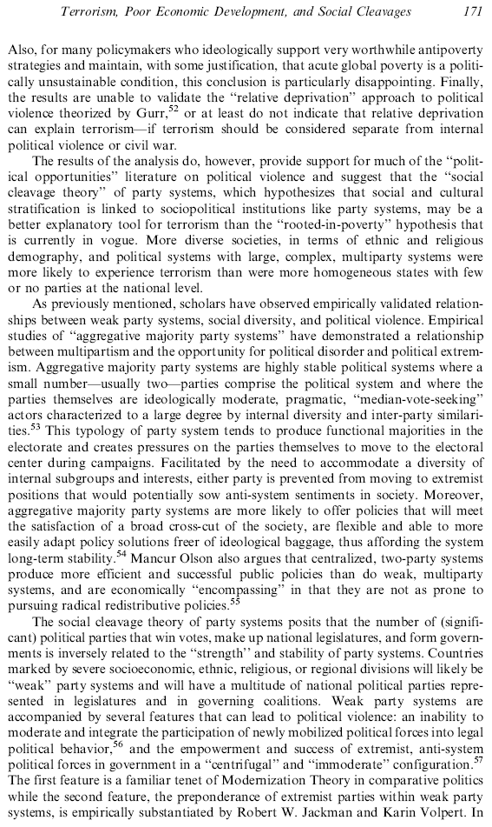

Slide 15
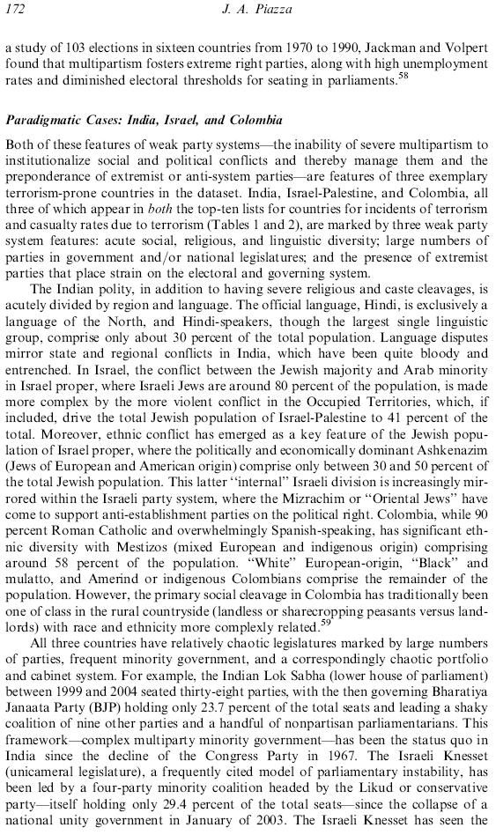

Slide 16
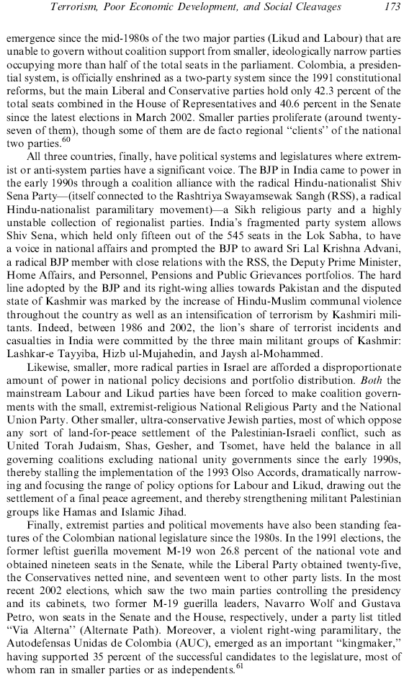

Slide 17
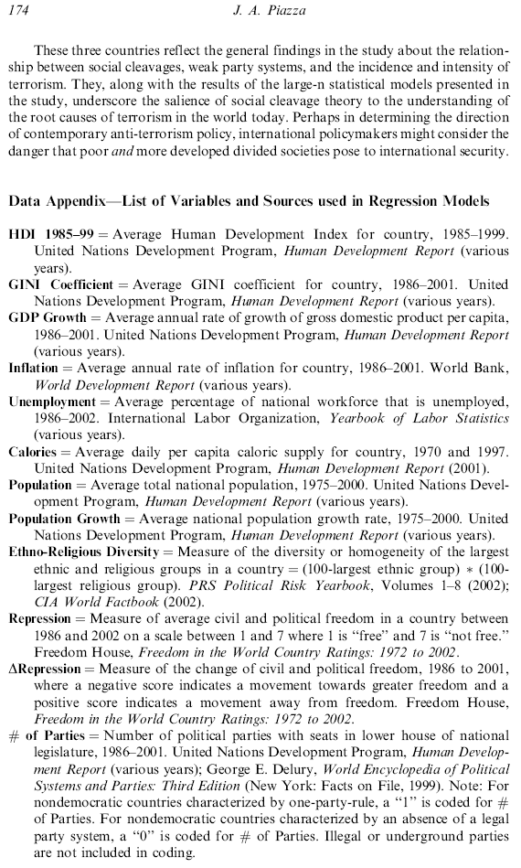
Comment 13:
This is the end of “Making Sense of Real Research #3.”
The following slides contain the answers to the questions.

Slide 18
Question 1:
Equation:
Incidents =
95.28 -.003 (GDP)
Adjusted r-squared:
-.017
Significance of slope:
.383
Therefore, according
to these data, GDP does not have an effect on incidents.

Slide 19
Question 2:
1.) to extend these analyses into the 1980s, 1990s, and early 2000s.
2.) to examine the effects of social cleavages.

Slide 20
Comment 5:
The GINI coefficient in an index of inequality, just like the IQV is an index of diversity.
Question 3:
In such a society, everyone would get the same exact income, so this would be a bit strange.
Comment 6:
As you can see, a lot of what researchers do in articles is define how they measured their variables. Please note that, in addition to these descriptions, there is an appendix on page 174.

Slide 21
Comment 7:
Don’t get hung up on how this variable is measured. Just understand that it goes from 0 to 100, where 0 is no diversity and 100 is maximum diversity.
Comment 8:
Freedom House is a well respected source of global political data.
Question 4:
Statsylvania would have gone from a 1 to a 7, so the change in repression score would be a 6.

Slide 22
Comment 9:
Having the standard error of the slope next to, or below, the slope is typical in articles.
Comment 10:
Note the odd star meaning here: a * means it’s statistically
significant, but at what level, we don’t know.
Question 5:
Incidents, because the R-square value is higher.
Question 6:
Fully interpret this slope.
Question 7:
What effect does diversity have on casualties?
Comment 11:
According to page 170,
this slope should be starred as significant.

Slide 23
Comment 9:
Having the standard error of the slope next to, or below, the slope is typical in articles.
Comment 10:
Note the odd star meaning here: a * means it’s statistically
significant, but at what level, we don’t know.
Question 5:
Which is easier to explain: incidents or casualties?
Question 6:
Assuming that population is measured in millions, a country with 300 million people, compared to a country with 200 million people would have .168 x 100 = 16.8 more incidents.
Comment 11:
According to page 170,
this slope should be starred as significant.

Slide 24
Comment 9:
Having the standard error of the slope next to, or below, the slope is typical in articles.
Comment 10:
Note the odd star meaning here: a * means it’s statistically
significant, but at what level, we don’t know.
Question 5:
Which is easier to explain: incidents or casualties?
Question 6:
Fully interpret this slope.
Question 7:
The higher the diversity in a country, the higher the number of casualties. Compared to a country with no diversity, a country with maximum diversity would have 100 x .264 = 26.4 more casualties.
Comment 11:
According to page 170,
this slope should be starred as significant.

Slide 25
Question 9:
What question does this interaction effect address?
Comment 12:
The way the article presents the interaction effects is rather odd: it seems that the parent slopes are not included.
Question 8:
The interaction question would be: does diversity have a different effect in smaller countires than in larger countries?

Slide 26
Question 9:
The interaction question would be: does the number of political parties have a different effect in larger countries than in smaller countries?
Comment 12:
The way the article presents the interaction effects is rather odd: it seems that the parent slopes are not included.
Question 8:
What question does this interaction effect address?

