Slide 1
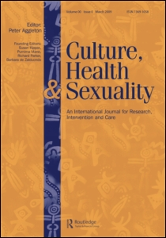
Making Sense of Real Research #2
“Men’s Concerns with Sex and Health
in Personal Advertisements”
By Voon Chin Phua et al
This article appeared in the
journal Culture, Health, &
Sexuality in 2002.
This Article Analysis will
guide you through the article
in two ways:
Blue Commentary Boxes:
Linneman’s comments to help you
understand elements in the article.
Green Question Boxes:
Linneman’s questions for you about
elements in the article. Answer the
question for yourself, and then click
on the box to see Linneman’s answer.
Click the box again to return to the
question.

Slide 2
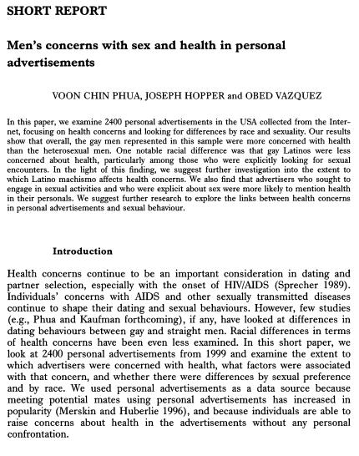
Comment 1:
In the abstract, the
authors describe their
major findings. Our
job will be to see how
they use statistics
to develop these
findings.

Slide 3
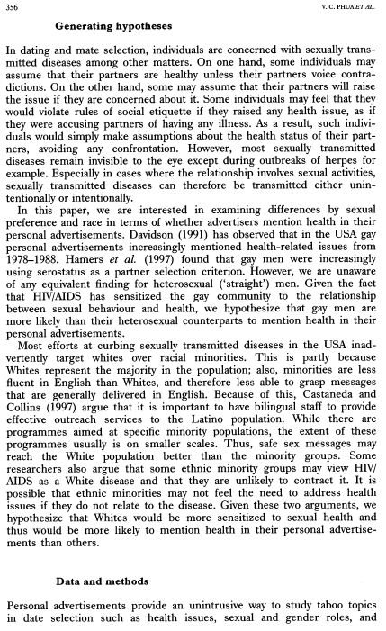
Comment 2:
Serostatus is a fancy
term for “HIV-positive
or not”.
Question 1:
What are the authors’
two major hypotheses?

Slide 4
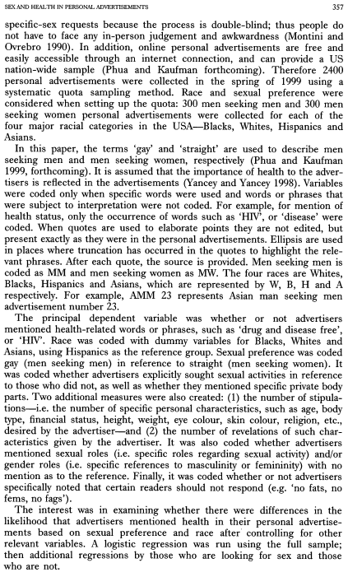
Comment 3:
The quota sampling method is less than ideal: we have no idea how they filled these quotas. Which online sites did the authors use? However, on the positive side, these sample sizes are substantial.
Question 2:
Given the nature of the dependent variable, what type of regression did the authors use, and why?

Slide 5
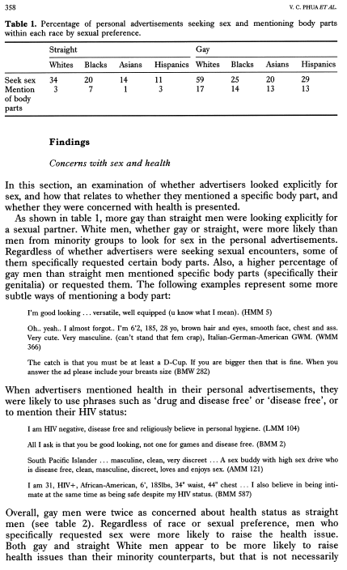
Question 3:
Convert these percentages to frequencies and run a chi-square test comparing the straight whites and straight blacks with regard to whether or not they seek sex.
Comment 3:
In describing how they measured this health variable, it would have been nice to see a comprehensive list of what counted as “mentioning health”. For example, would “you must be healthy” count as mentioning health?

Slide 6
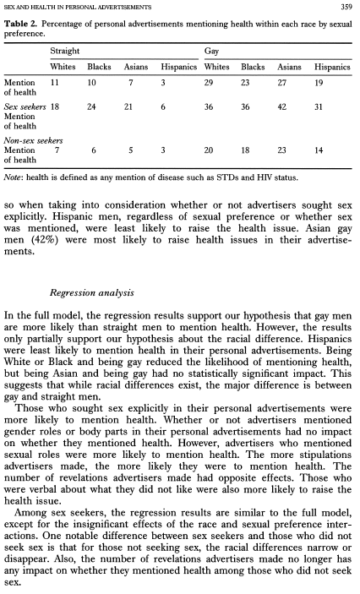
Question 4:
Convert these percentages to frequencies and run a chi-square test comparing the gay Asians and gay Hispanics with regard to whether or not they mention health.
Question 5:
Using Tables 1 & 2, fully describe the relationships among white gay men, seeking sex, and mentioning health.
Comment 4:
Read these paragraphs carefully, as we’ll be looking closely at the table on the next page, which provides the evidence for the claims in these paragraphs.

Slide 7
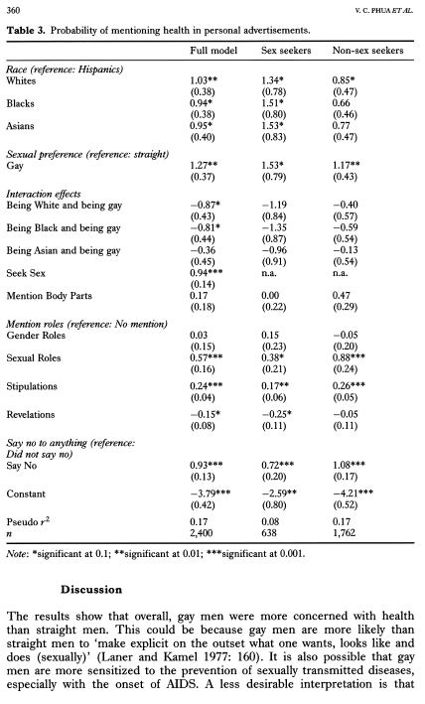
Question 6:
Using the Sex seekers
model, predict the probability of mentioning health for:
1.) a Hispanic straight man who does not mention anything special.
2.) a Hispanic gay
man who does not mention anything special.
Question 7:
What question are these interaction terms addressing?
Question 8:
Why are these here?
Comment 5:
Note that a single star denotes significance at .1, not <.05, as usual.

Slide 8
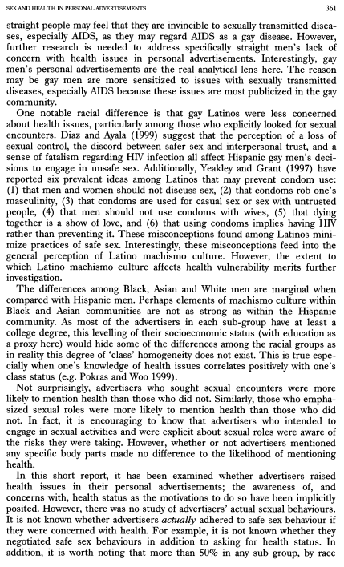

Slide 9
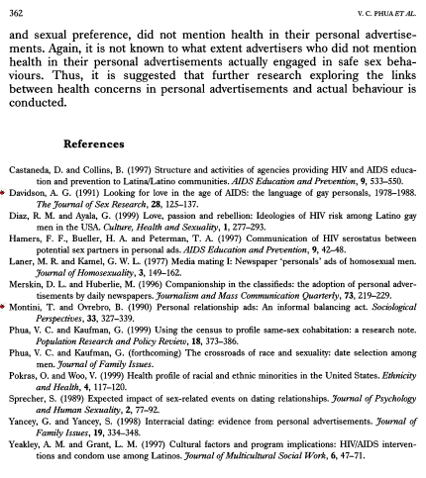
Comment 6:
This is the end of “Making Sense of Real Research #2.”
The following slides contain the answers to the questions.

Slide 10
Comment 2:
Serostatus is a fancy
term for “HIV-positive
or not”.
Question 1:
H1: gay men are more likely than straight men to mention health.
H2: whites are more likely to mention health than nonwhites.

Slide 11
Comment 3:
The quota sampling method is less than ideal: we have no idea how they filled these quotas. Which online sites did the authors use? However, on the positive side, these sample sizes are substantial.
Question 2:
The dependent variable is whether someone mentioned health OR NOT. Therefore, given they have a dichotomous dependent variable, they use logistic regression.

Slide 12
Question 3:
White Blacks
Sex 102 60
No Sex 198 240
Chi-Square=14.92
p<.001
Comment 3:
In describing how they measured this health variable, it would have been nice to see a comprehensive list of what counted as “mentioning health”. For example, would “you must be healthy” count as mentioning health?

Slide 13
Question 4:
White Blacks
Sex 81 57
No Sex 219 243
Chi-Square=5.42
p<.05
Question 5:
Using Tables 1 & 2, fully describe the relationships among white gay men, seeking sex, and mentioning health.
Comment 4:
Read these paragraphs carefully, as we’ll be looking closely at the table on the next page, which provides the evidence for the claims in these paragraphs.

Slide 14
Question 4:
Convert these percentages to frequencies and run a chi-square test comparing the gay Asians and gay Hispanics with regard to whether or not they mention health.
Question 5:
White gay men are more likely to seek sex. Sex seekers are more likely to mention health. Whites are more likely to mention health, until you control for sex seeking.
Comment 4:
Read these paragraphs carefully, as we’ll be looking closely at the table on the next page, which provides the evidence for the claims in these paragraphs.

Slide 15
Question 6:
1.) a Hispanic straight man who does not mention anything special:
z = -2.59,
probability= 7%
2.) a Hispanic gay
man who does not mention anything special:
z = -1.06
probability = 26%
Question 7:
What question are these interaction terms addressing?
Question 8:
Why are these here?
Comment 5:
Note that a single star denotes significance at .1, not <.05, as usual.

Slide 16
Question 6:
Using the Sex seekers
model, predict the probability of mentioning health for:
1.) a Hispanic gay man who does not mention anything special.
2.) a Hispanic straight
man who does not mention anything special.
Question 7:
Does being gay affect the probability of mentioning health differently for different races?
Question 8:
Why are these here?
Comment 5:
Note that a single star denotes significance at .1, not <.05, as usual.

Slide 17
Question 6:
Using the Sex seekers
model, predict the probability of mentioning health for:
1.) a Hispanic gay man who does not mention anything special.
2.) a Hispanic straight
man who does not mention anything special.
Question 7:
What question are these interaction terms addressing?
Question 8:
Since these models hold constant sex seeking, the seek sex variable cannot be in these models.
Comment 5:
Note that a single star denotes significance at .1, not <.05, as usual.

