Slide 1

Making Sense of Real Research #1
“News Coverage of Social Protests and the
Effects of Photographs and Prior Attitudes”
By Laura Arpan et al
This article appeared in the
journal Mass Communication
& Society in 2006.
This Article Analysis will
guide you through the article
in two ways:
Blue Commentary Boxes:
Linneman’s comments to help you
understand elements in the article.
Green Question Boxes:
Linneman’s questions for you about
elements in the article. Answer the
question for yourself, and then click
on the box to see Linneman’s answer.
Click the box again to return to the
question.

Slide 2
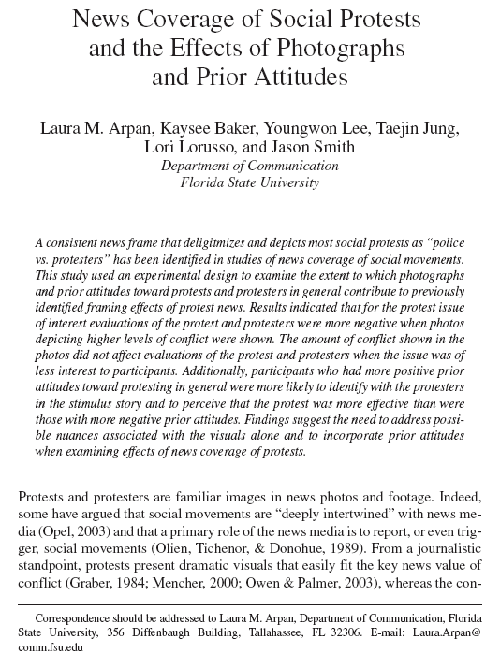
Comment 1:
While most social science
articles involving statistics
use the survey method to
collect their data, some
research uses experiments.
This study is an example
of this type of research.
Comment 2:
This italicized paragraph is
the abstract of the article,
and it summarizes the
overall results. Our job is
to see how the article’s
authors used statistics to
come up with these
results.

Slide 3
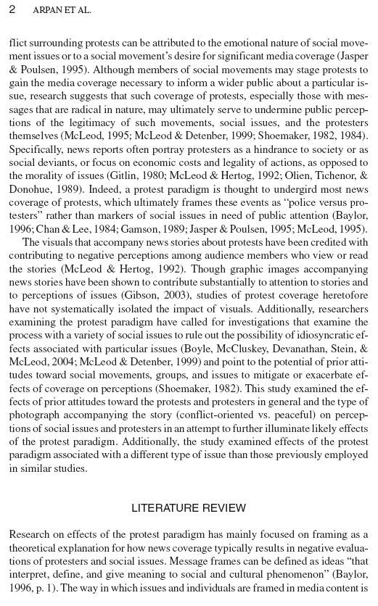
Question 1:
What is the Protest
Paradigm?
Comment 3:
It is typical at the end
of the introduction to
describe the major
contributions of the
study, as the authors
do here.
Comment 4:
From here to the bottom
of page 6, the authors
situate their study within
the existing research
literature. As we’re more
interested in the study
itself, skim through this
part and meet me at the
bottom of page 6.

Slide 4
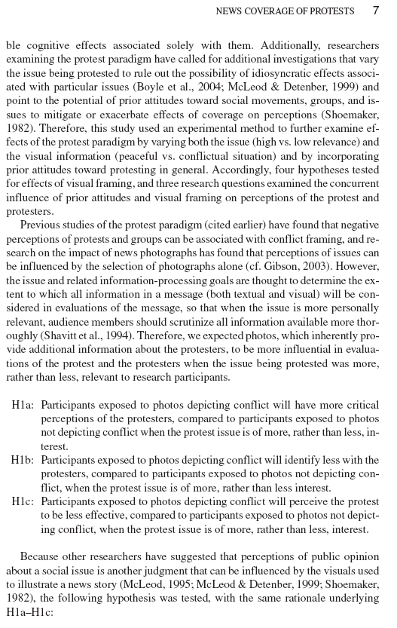
Comment 5:
Here is the first sign of
the authors laying out
how they conducted their
study. Notice that they
are starting to tell you
what the independent
variables are: relevance,
level of conflict, and prior
attitudes toward protest.
Question 2:
For each hypothesis
(these three and the
hypothesis on the
following page),
what are the
independent and
dependent variables?

Slide 5
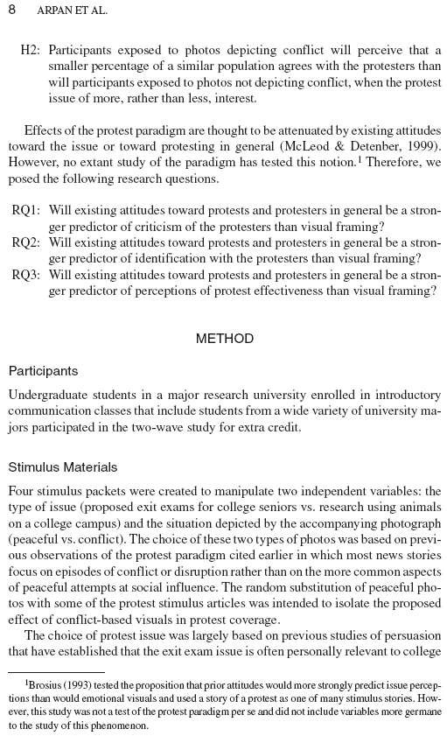
Question 3:
What type of statistical
procedure do you think
they will use to address
these research questions?
(Hint: focus on the term
“stronger predictor”)
Comment 6:
Note that the study’s
participants were
college undergraduates,
and that they were not
drawn from a random
sample. This may affect
how generalizable the
results are to a larger
population.
Comment 7:
Here are the categories for the independent
variables.

Slide 6
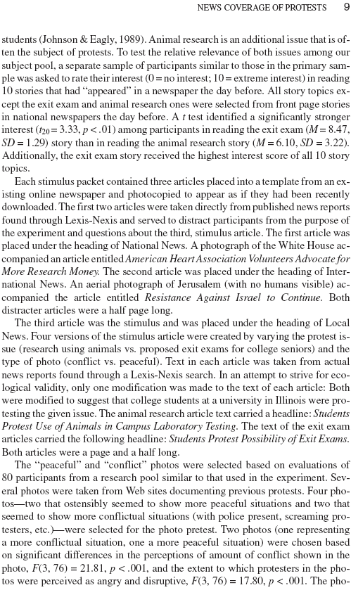
Question 4:
Assume from the t₂₀ that 20 students were involved in this t-test, and they ranked each article. Therefore, the two sample sizes are each 20. Use the formula for t to calculate a t-value. Hint: you won’t get exactly 3.33.
Comment 8:
I find it useful to sketch out what they’re doing here:
animal research
and peaceful
exit exam
and peaceful
animal research
and conflict
exit exam
and conflict
Question 5:
Which statistical test
do you think they
used here?

Slide 7
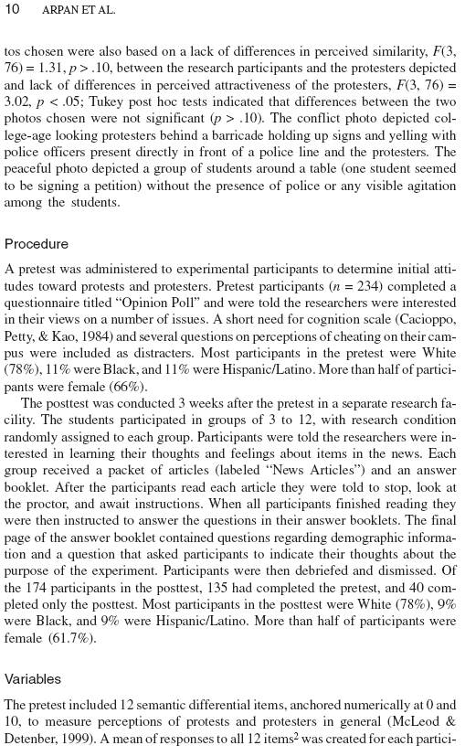
Comment 9:
Though most of the time researchers use
statistical tests to show differences, occasionally they will use them to show that there is no difference, as the authors do here.

Slide 8
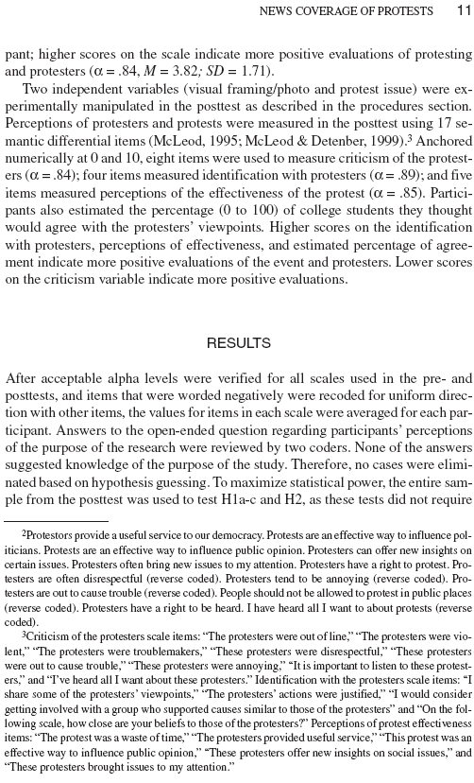
Comment 10:
This symbol stands for alpha, and it is a measure of how well the items of an index go together. An alpha of .84 is good.
Comment 11:
All of the variables are measured so that a higher # means positive towards protest, EXCEPT for this criticism variable, where a higher number means more critical.

Slide 9
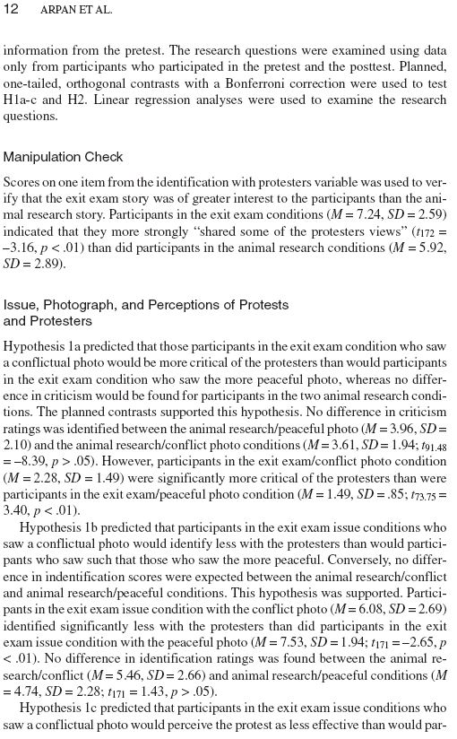
Comment 12:
This is fancy talk for
some type of t-tests.
Don’t let it scare you.
Question 6:
Use this last set of numbers to carry out
a t-test on your own.
Use 74 for each of the sample sizes. Don’t worry if your t-value differs from the authors’. Is your p-conclusion the same as theirs?

Slide 10
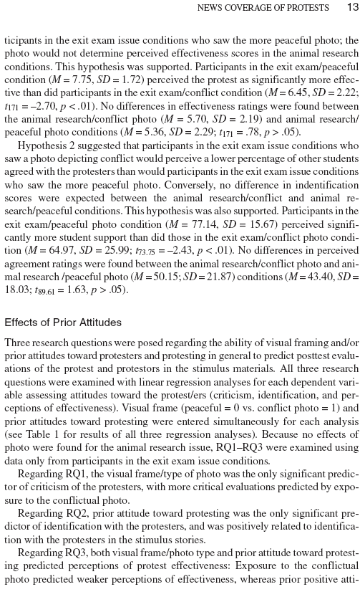
Question 7:
All of the authors’ hypotheses are supported: they observe, with t-tests, statistically significant differences where they expected to observe differences. But how does their sampling procedure diminish these results?
Comment 13:
Here, the authors describe their regression equations. Notice that they are using only a subset of their data.

Slide 11
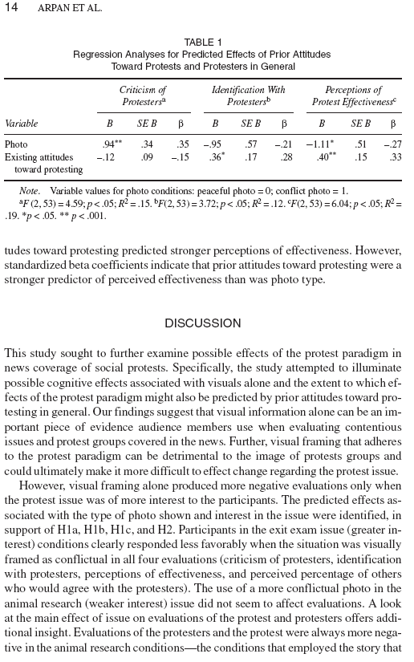
Question 8:
Explicitly describe what this .94 means.
Question 9:
To which specific numbers are the authors referring here?
Comment 14:
The rest of the article carefully describes the implications and limitations of this project.
Comment 15:
This is the end of “Making Sense of Real Research #1.”
The following slides contain the answers to the questions.

Slide 12
Question 1:
The Protest Paradigm
is the tendency for
journalists to cover
protest events as
“us versus them”
situations, where the
protesters are fighting
against the police.
Comment 3:
It is typical at the end
of the introduction to
describe the major
contributions of the
study, as the authors
do here.
Comment 4:
From here to the bottom
of page 6, the authors
situate their study within
the existing research
literature. As we’re more
interested in the study
itself, skim through this
part and meet me at the
bottom of page 6.

Slide 13
Comment 5:
Here is the first sign of
the authors laying out
how they conducted their
study. Notice that they
are starting to tell you
what the independent
variables are: relevance,
level of conflict, and prior
attitudes toward protest.
Question 2:
H1a: DV: perceptions of
protesters; IVs: level of
conflict in photos, interest
level in issue.
H1b: DV: identification
with protesters; IVs:
level of conflict in photos,
interest level in issue.
H1c: DV: perceived
effectiveness of protest;
IVs: level of conflict in
photos, interest in issue.
H2: DV: perceived
percentage of people
agreeing with protesters;
IVs: level of conflict in
photos, interest in issue.

Slide 14
Question 3:
If they’re asking what the
stronger predictor is of
these two variables, it is
likely they will look at the
betas in a multiple
regression equation. The
variable with the bigger
beta will have the larger
effect.
Comment 6:
Note that the study’s
participants were
college undergraduates,
and that they were not
drawn from a random
sample. This may affect
how generalizable the
results are to a larger
population.
Comment 7:
Here are the categories for the independent
variables.

Slide 15

Question 4:
Using the formula, for
t, I calculate the
following:
Why this is a bit lower
than their 3.33, I don’t know. It may be because we don’t
know exactly what
their t₂₀ means.
Comment 8:
I find it useful to sketch out what they’re doing here:
animal research
and peaceful
exit exam
and peaceful
animal research
and conflict
exit exam
and conflict
Question 5:
Which statistical test
do you think they
used here?

Slide 16
Question 4:
Assume from the t₂₀ that 20 students were involved in this t-test, and they ranked each article. Therefore, the two sample sizes are each 20. Use the formula for t to calculate a t-value. Hint: you won’t get exactly 3.33.
Comment 8:
I find it useful to sketch out what they’re doing here:
animal research
and peaceful
exit exam
and peaceful
animal research
and conflict
exit exam
and conflict
Question 5:
They most likely used
some type of ANOVA
here, as the ANOVA
procedure involves an
F statistics. Plus, they were testing the means on four photos, and ANOVA is used when you have more than two means.

Slide 17

Comment 12:
This is fancy talk for
some type of t-tests.
Don’t let it scare you.
Question 6:
Using the formula, for
t, I calculate the
following:
This differs a bit from their 3.40, but
the p-conclusion is
the same: p<.01.

Slide 18
Question 7:
Since their sampling procedure did not involve a random sample, there is not a larger population to which to generalize these results. However, the fact that they did randomly put the students into the various groups is important.
Comment 13:
Here, the authors describe their regression equations. Notice that they are using only a subset of their data.

Slide 19
Question 8:
Students shown the conflict photo were .94 higher on the criticism of protesters index than students shown the peaceful photo, meaning that they were more critical of the protesters.
Question 9:
To which specific numbers are the authors referring here?
Comment 14:
The rest of the article carefully describes the implications and limitations of this project.

Slide 20
Question 8:
Explicitly describe what this .94 means.
Question 9:
They are referring to the -.27 and the .33 in the rightmost column. Because the .33 is larger than the .27, they claim that attitudes toward protesting have a larger effect than photo type.
Comment 14:
The rest of the article carefully describes the implications and limitations of this project.

