Slide 1
Making Sense of SPSS Output:
Non-Linear Effects
On the following slide,
you will find some SPSS regression output
using GSS2022 data.
Try to make sense of the output
by answering the questions that
are asked.

Slide 2
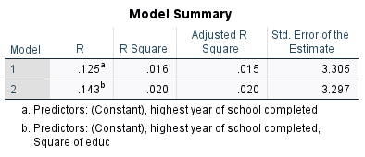
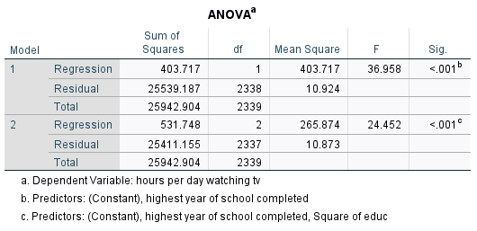
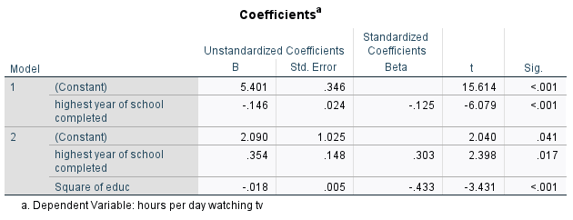

Slide 3
Question 1:
What is the dependent
variable in this regression?

Slide 4
Question 1:
What is the dependent
variable in this regression?
Answer:
The dependent variable
is the hours of television
the respondent reports
watching.

Slide 5
Question 2:
What is the independent
variable in Model 1?

Slide 6
Question 2:
What is the independent
variable in Model 1?
Answer:
The independent variable
in Model 1 is years of
education.

Slide 7
Question 3:
Interpret the effect of
years of education in
Model 1.

Slide 8
Question 3:
Interpret the effect of
years of education in
Model 1.
Answer:
The variable has a
statistically significant
effect: for each year of
education, tv hours goes
down by .146 hours.

Slide 9
Question 4:
What variable is added
in Model 2?

Slide 10
Question 4:
What variable is added
in Model 2?
Answer:
The variable added in
Model 2 is the square of
the education variable.

Slide 11
Question 5:
Does Model 2 do a better
job of explaining variation
than Model 1?

Slide 12
Question 5:
Does Model 2 do a better
job of explaining variation
than Model 1?
Answer:
Yes, Model 2 explains
more variation in the
dependent variable than
Model 1.

Slide 13
Question 6:
What is the regression
equation from Model 2?

Slide 14
Question 6:
What is the regression
equation from Model 2?
Answer:
tvhours = 2.090 +.354(educ) -.018(educ)(educ)

Slide 15
Question 7:
Use the regression
equation to make a
prediction for someone
with 10 years education.

Slide 16
Question 7:
Use the regression
equation to make a
prediction for someone
with 10 years education.
Answer:
tvhours = 2.090 +.354(10) -.018(10)(10)=3.83

Slide 17
Question 8:
Use the regression
equation to make a
prediction for someone
with 11 years education.

Slide 18
Question 8:
Use the regression
equation to make a
prediction for someone
with 11 years education.
Answer:
tvhours = 2.090 +.354(11) -.018(11)(11)=3.806

Slide 19
Question 9:
What is the difference
in tv hours between
10 years and 11 years?

Slide 20
Question 9:
What is the difference
in tv hours between
10 years and 11 years?
Answer:
difference = 3.83 - 3.806 = .024 hours

Slide 21
Question 10:
Use the regression
equation to make a
prediction for someone
with 19 years education.

Slide 22
Question 10:
Use the regression
equation to make a
prediction for someone
with 19 years education.
Answer:
tvhours = 2.090 +.354(19) -.018(19)(19)=2.318

Slide 23
Question 10:
Use the regression
equation to make a
prediction for someone
with 20 years education.

Slide 24
Question 10:
Use the regression
equation to make a
prediction for someone
with 20 years education.
Answer:
tvhours = 2.090 +.354(20) -.018(20)(20)=1.97

Slide 25
Question 11:
What is the difference
in tv hours between
19 years and 20 years?

Slide 26
Question 11:
What is the difference
in tv hours between
19 years and 20 years?
Answer:
difference = 2.318 – 1.97 = .348 hours

Slide 27
Question 12:
Describe the overall
nonlinear effect.

Slide 28
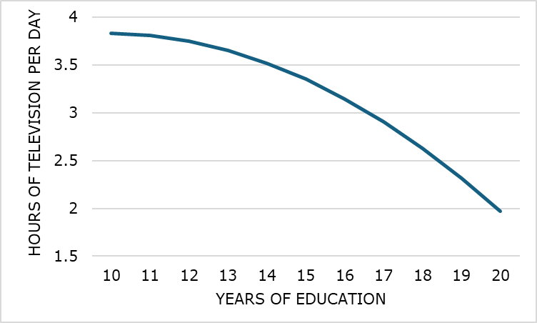
Question 12:
Describe the overall
nonlinear effect.
Answer:
At lower levels of education, each additional year
doesn’t lower tv hours by much, but at higher levels
of education, each additional year lowers tv hours
by a fair amount.

