Slide 1
Making Sense of SPSS Output:
Nested Models
On the following slide,
you will find some SPSS regression output
using GSS2022 data.
Try to make sense of the output
by answering the questions that
are asked.

Slide 2
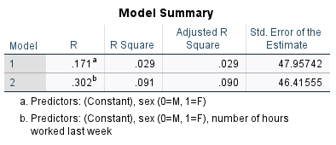
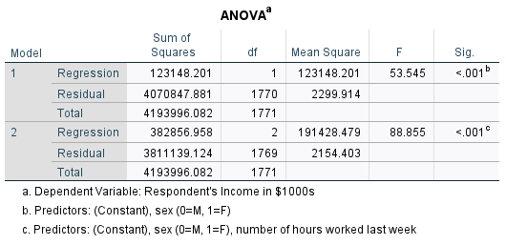
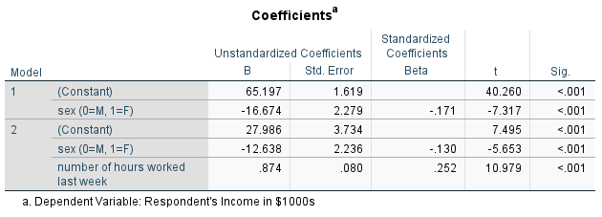

Slide 3
Question 1:
What is the
dependent variable
in this output?

Slide 4
Question 1:
What is the
dependent variable
in this output?
Answer:
Respondent’s Income
in $1000s

Slide 5
Question 2:
What is the only
independent variable
in Model 1?

Slide 6
Question 2:
What is the only
independent variable
in Model 1?
Answer:
Sex of respondent

Slide 7
Question 3:
According to Model 1,
who makes less income, men or women?
How much less?

Slide 8
Question 3:
According to Model 1,
who makes less income, men or women?
How much less?
Answer:
Women make less.
$16,674 less.

Slide 9
Question 4:
According to Model 1, what is men’s mean
income?

Slide 10
Question 4:
According to Model 1, what is men’s mean
income?
Answer:
Men make on average
$65,197.

Slide 11
Question 5:
Can you say that,
in the population,
there is a sex
difference in income?

Slide 12
Question 5:
Can you say that,
in the population,
there is a sex
difference in income?
Answer:
Yes, the slope for sex
is statistically significant at the
p<.001 level, so we
can say that there
is a difference in the
population.

Slide 13
Question 6:
How much variation
in income can sex alone explain?

Slide 14
Question 6:
How much variation
in income does sex alone explain?
Answer:
Sex explains 2.9%
of the variation in income.

Slide 15
Question 7:
What is the control
variable added in
Model 2?

Slide 16
Question 7:
What is the control
variable added in
Model 2?
Answer:
Number of hours worked last week.

Slide 17
Question 8:
Describe the effect
of working an
additional hour.

Slide 18
Question 8:
Describe the effect
of working an
additional hour.
Answer:
For each additional
hour worked, one makes $874
(this is over the course
of the whole year).

Slide 19
Question 9:
What happens to the
sex effect once we
control for hours worked?

Slide 20
Question 9:
What happens to the
sex effect once we
control for hours worked?
Answer:
The effect of sex
declines by around
$4,000, but it remains
statistically significant.

Slide 21
Question 10:
How much variation
can sex and hours worked together
explain?

Slide 22
Question 10:
How much variation
can sex and hours worked together
explain?
Answer:
Together these two
variables explain 9%
of the variation in income.

Slide 23
Question 11:
Which independent variable has the largest effect?

Slide 24
Question 11:
Which independent variable has the largest effect?
Answer:
Hours worked has the
largest beta, so it has
the largest effect.

Slide 25
Question 12:
How many cases are involved in this regression?

Slide 26
Question 12:
How many cases are involved in this regression?
Answer:
There are 1771+1,
or 1,772 cases in this
regression.

