Slide 1
Making Sense of SPSS Output:
Elaborated Crosstabs with Chi-Square
On the following slide,
you will find some SPSS regression output
using GSS2022 data.
Try to make sense of the output
by answering the questions that
are asked.

Slide 2
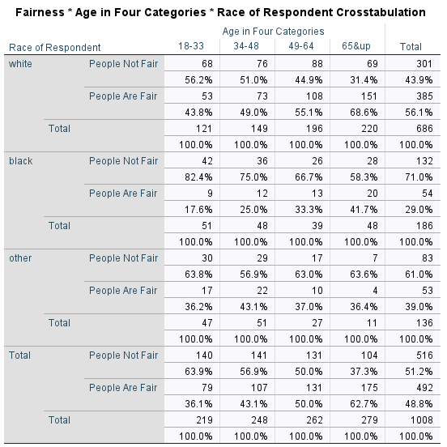
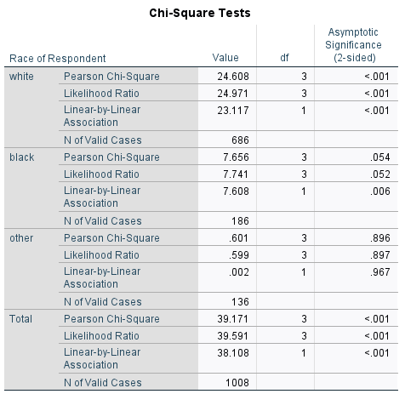

Slide 3
Question 1:
What is the dependent variable
in this output?

Slide 4
Question 1:
What is the dependent variable
in this output?
Answer:
The dependent variable in this
output is: Are People Fair?

Slide 5
Question 2:
What is the independent variable
in this output?

Slide 6
Question 2:
What is the independent variable
in this output?
Answer:
The independent variable in this
output is:
Age in Four Categories

Slide 7
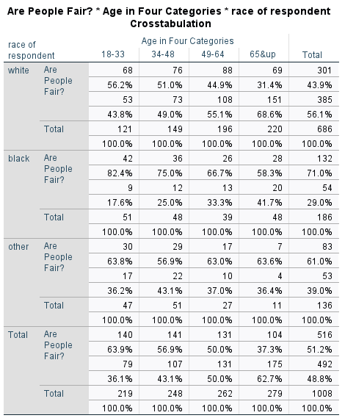

Question 3:
What is the elaboration variable
in this output?

Slide 8
Question 3:
What is the elaboration variable
in this output?
Answer:
The elaboration variable in this
output is:
race of respondent

Slide 9
Question 4:
Describe the overall relationship
between age and belief in
people’s fairness.

Slide 10
Question 4:
Describe the overall relationship
between age and belief in
people’s fairness.
Answer:
There is a clear relationship
between age and belief in
fairness: As people get older,
they are much more likely
to feel that people are fair.

Slide 11
Question 5:
Which type of person, in terms
of race and age, is the LEAST
likely to think people are fair?

Slide 12
Question 5:
Which type of person, in terms
of race and age, is the LEAST
likely to think people are fair?
Answer:
A young Black person is the
least likely to think that
people are fair.

Slide 13
Question 6:
Are you able to claim that,
in the population of white
people, that age affects
attitude toward fairness?

Slide 14
Question 6:
Are you able to claim that,
in the population of white
people, that age affects
attitude toward fairness?
Answer:
Yes, according to the chi-square
test, the p-value is p<.001,
so you can say that in the
white population, age affects
attitude toward fairness.

Slide 15
Question 7:
Are you able to claim that,
in the population of Black
people, that age affects
attitude toward fairness?

Slide 16
Question 7:
Are you able to claim that,
in the population of Black
people, that age affects
attitude toward fairness?
Answer:
No, according to the chi-square
test, the p-value is above .05,
so we cannot say that in the
Black population, age affects
attitude toward fairness.
Some might say the
relationship is “marginally
significant,” since it comes close
to reaching the p<.05 cutoff.

Slide 17
Question 8:
Are you able to claim that,
in the population of other
people, that age affects
attitude toward fairness?

Slide 18
Question 8:
Are you able to claim that,
in the population of other
people, that age affects
attitude toward fairness?
Answer:
No, according to the chi-square
test, the p-value is far above .05,
so we cannot say that in the
other population, age affects
attitude toward fairness.

Slide 19
Question 9:
The age differences among
Black respondents are similar
in size to the age differences
among white respondents.
Why don’t the Black results
achieve statistical significance?

Slide 20
Question 9:
The age differences among
Black respondents are similar
in size to the age differences
among white respondents.
Why don’t the Black results
achieve statistical significance?
Answer:
Chi-square is dependent on
sample size, and the white
crosstab has 686 cases,
whereas the Black crosstab
has only 186 cases.

Slide 21
Question 10:
Why is the crosstab for others (those neither white or Black)
so far from achieving statistical significance, with a p-value of
of .896?

Slide 22
Question 10:
Why is the crosstab for others (those neither white or Black)
so far from achieving statistical significance, with a p-value of
of .896?
Answer:
In the other crosstab, the
observed frequencies are very
close to one another, and very
similar to the expected
frequencies when there is
no relationship. This gives you
a very small chi-square value.

