Slide 1
Making Sense of SPSS Output:
Table of Descriptive Statistics
On the following slide,
you will find some SPSS regression output
using GSS2022 data.
Try to make sense of the output
by answering the questions that
are asked.

Slide 2
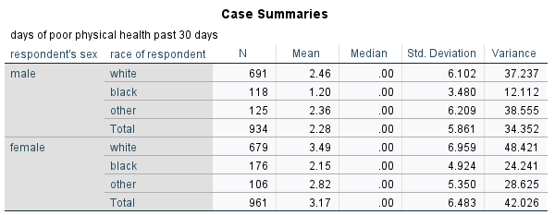
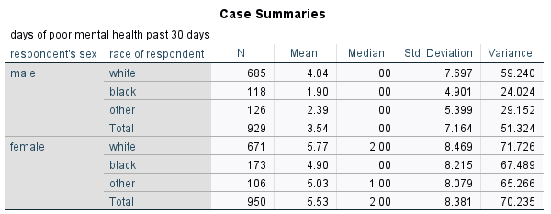

Slide 3
Question 1:
In the physical health table,
how many white male
respondents were there?

Slide 4
Question 1:
In the physical health table,
how many white male
respondents are there?
Answer:
There are 691 white males.

Slide 5
Question 2:
In the mental health table,
how many Black female
respondents are there?

Slide 6
Question 2:
In the mental health table,
how many Black female
respondents are there?
Answer:
There are 173 Black females.

Slide 7
Question 3:
Which group (combining
sex and race) had the highest
mean number of poor
mental health days?

Slide 8
Question 3:
Which group (combining
sex and race) had the highest
mean number of poor
mental health days?
Answer:
White females had the highest
mean number of poor
mental health days.

Slide 9
Question 4:
In the physical health table,
the medians are all 0,
while the means are higher.
What does this tell you?

Slide 10
Question 4:
In the physical health table,
the medians are all 0,
while the means are higher.
What does this tell you?
Answer:
This tells you that there are
some respondents with a
high number of poor physical
health days pulling the mean
up.

Slide 11
Question 5:
How much more variation in
poor physical health days is
there among white males
compared to Black males?

Slide 12
Question 5:
How much more variation in
poor physical health days is
there among white males
compared to Black males?
Answer:
There is:
37.237 / 12.112 = 3.07,
over three times the variation.

Slide 13
Question 6:
How much more variation in
poor physical health days is
there among white males
compared to other males
(those neither white nor Black)?

Slide 14
Question 6:
How much more variation in
poor physical health days is
there among white males
compared to other males
(those neither white nor Black)?
Answer:
There is:
59.240 / 29.152 = 2.03,
over twice the variation.

Slide 15
Question 7:
How much more unique is a
Black female who has 12 poor
physical health days compared
to a white female who has
12 poor physical health days?

Slide 16
Question 7:
Who is more unique:
a Black female who has 12 poor
physical health days, or
a white female who has
12 poor physical health days?
Answer:
A Black female is:
(12-2.15)/4.924 = 2.00 SDs
A white female is:
(12-3.49)/6.959 = 1.22 SDs
A Black female is more
unique.

Slide 17
Question 8:
Who is more unique:
a Black male who has 12 poor
mental health days, or
a white male who has
12 poor mental health days?

Slide 18
Question 8:
Who is more unique:
a Black male who has 12 poor
mental health days, or
a white male who has
12 poor mental health days?
Answer:
A Black male is:
(12-1.90)/4.901 = 2.06 SDs
A white male is:
(12-4.04)/7.697 = 1.03 SDs
A Black male is more
unique.

